Slide 1
Chapter 22 – Java Media Framework and Java Sound
Outline
22.1 Introduction
22.2 Playing Media
22.3 Formatting and Saving Captured Media
22.4 RTP Streaming
22.5 Java Sound
22.6 Playing Sampled Audio
22.7 Musical Instrument Digital Interface (MIDI)
22.7.1 MIDI Playback
22.7.2 MIDI Recording
22.7.3 MIDI Synthesis
22.7.4 Class MidiDemo
22.9 (Optional Case Study) Thinking About Objects: Animation and Sound in the View

Slide 2
22.1 Introduction
Java Media Framework (JMF) API
  Play, edit, stream and capture many popular media formats
  Latest version is JMF 2.1.1

Slide 3
22.2 Playing Media
Playing a media clip
  An object that implements Player interface
    Specify media source
    Create a Player for the media
    Obtain output media and Player controls
    Display the media and controls

Slide 4
Fig. 22.1 Playing media with interface Player.
Line 13
Line 18
Line 21
Line 24
Lines 30-31
1 // Fig. 22.1: SimplePlayer.java
2 // Opens and plays a media file from
3 // local computer, public URL, or an RTP session
4
5 // Java core packages
6 import java.awt.*;
7 import java.awt.event.*;
8 import java.io.*;
9 import java.net.*;
10
11 // Java extension packages
12 import javax.swing.*;
13 import javax.media.*;
14
15 public class SimplePlayer extends JFrame {
16
17 // Java media player
18 private Player player;
19
20 // visual content component
21 private Component visualMedia;
22
23 // controls component for media
24 private Component mediaControl;
25
26 // main container
27 private Container container;
28
29 // media file and media locations
30 private File mediaFile;
31 private URL fileURL;
32
Import JMF extension packages
Declare Player object to play media files
Declare visual content component
Declare controls component
Declare media file and media locations

Slide 5
Fig. 22.1 Playing media with interface Player (Part 2).
Lines 52-78
Line 57
Line 63
33 // constructor for SimplePlayer
34 public SimplePlayer()
35 {
36 super( "Simple Java Media Player" );
37
38 container = getContentPane();
39
40 // panel containing buttons
41 JPanel buttonPanel = new JPanel();
42 container.add( buttonPanel, BorderLayout.NORTH );
43
44 // opening file from directory button
45 JButton openFile = new JButton( "Open File" );
46 buttonPanel.add( openFile );
47
48 // register an ActionListener for openFile events
49 openFile.addActionListener(
50
51 // anonymous inner class to handle openFile events
52 new ActionListener() {
53
54 // open and create player for file
55 public void actionPerformed( ActionEvent event )
56 {
57 mediaFile = getFile();
58
59 if ( mediaFile != null ) {
60
61 // obtain URL from file
62 try {
63 fileURL = mediaFile.toURL();
64 }
65
ActionListener for openFile events opens file and creates player for file
When user clicks button, call method getFile which prompts user to select a file
Call method toURL to get a URL reference to the file

Slide 6
Fig. 22.1 Playing media with interface Player (Part 3).
Line 72
Lines 90-101
Line 95
Line 98
Call method makePlayer to create a player for the file
66 // file path unresolvable
67 catch ( MalformedURLException badURL ) {
68 badURL.printStackTrace();
69 showErrorMessage( "Bad URL" );
70 }
71
72 makePlayer( fileURL.toString() );
73
74 }
75
76 } // end actionPerformed
77
78 } // end ActionListener
79
80 ); // end call to method addActionListener
81
82 // URL opening button
83 JButton openURL = new JButton( "Open Locator" );
84 buttonPanel.add( openURL );
85
86 // register an ActionListener for openURL events
87 openURL.addActionListener(
88
89 // anonymous inner class to handle openURL events
90 new ActionListener() {
91
92 // open and create player for media locator
93 public void actionPerformed( ActionEvent event )
94 {
95 String addressName = getMediaLocation();
96
97 if ( addressName != null )
98 makePlayer( addressName );
99 }
100
ActionListener for openURL events opens and creates player for media locator
Calling method getMediaLocation prompts user for a string for location of media
Call method makePlayer to create a player for media locator

Slide 7
Fig. 22.1 Playing media with interface Player (Part 4).
Lines 107-108
Lines 120-134
101 } // end ActionListener
102
103 ); // end call to method addActionListener
104
105 // turn on lightweight rendering on players to enable
106 // better compatibility with lightweight GUI components
107 Manager.setHint( Manager.LIGHTWEIGHT_RENDERER,
108 Boolean.TRUE );
109
110 } // end SimplePlayer constructor
111
112 // utility method for pop-up error messages
113 public void showErrorMessage( String error )
114 {
115 JOptionPane.showMessageDialog( this, error, "Error",
116 JOptionPane.ERROR_MESSAGE );
117 }
118
119 // get file from computer
120 public File getFile()
121 {
122 JFileChooser fileChooser = new JFileChooser();
123
124 fileChooser.setFileSelectionMode(
125 JFileChooser.FILES_ONLY );
126
127 int result = fileChooser.showOpenDialog( this );
128
129 if ( result == JFileChooser.CANCEL_OPTION )
130 return null;
131
132 else
133 return fileChooser.getSelectedFile();
134 }
135
Use lightweight rendering on players
Method getFile gets a file from the computer

Slide 8
Fig. 22.1 Playing media with interface Player (Part 5).
Lines 137-147
Lines 150-187
Line 154
Lines 157-158
Method getMediaLocation gets media location from user input
136 // get media location from user input
137 public String getMediaLocation()
138 {
139 String input = JOptionPane.showInputDialog(
140 this, "Enter URL" );
141
142 // if user presses OK with no input
143 if ( input != null && input.length() == 0 )
144 return null;
145
146 return input;
147 }
148
149 // create player using media's location
150 public void makePlayer( String mediaLocation )
151 {
152 // reset player and window if previous player exists
153 if ( player != null )
154 removePlayerComponents();
155
156 // location of media source
157 MediaLocator mediaLocator =
158 new MediaLocator( mediaLocation );
159
160 if ( mediaLocator == null ) {
161 showErrorMessage( "Error opening file" );
162 return;
163 }
164
165 // create a player from MediaLocator
166 try {
167 player = Manager.createPlayer( mediaLocator );
168
Method makePlayer creates a Player for a media clip
Invoked method removePlayerComponents to remove previous player
Create new MediaLocator for media source

Slide 9
Fig. 22.1 Playing media with interface Player (Part 6).
Lines 170-171
Line 174
Lines 191-203
Line 202
Register ControllerListener to handle Player events
169 // register ControllerListener to handle Player events
170 player.addControllerListener(
171 new PlayerEventHandler() );
172
173 // call realize to enable rendering of player's media
174 player.realize();
175 }
176
177 // no player exists or format is unsupported
178 catch ( NoPlayerException noPlayerException ) {
179 noPlayerException.printStackTrace();
180 }
181
182 // file input error
183 catch ( IOException ioException ) {
184 ioException.printStackTrace();
185 }
186
187 } // end makePlayer method
188
189 // return player to system resources and
190 // reset media and controls
191 public void removePlayerComponents()
192 {
193 // remove previous video component if there is one
194 if ( visualMedia != null )
195 container.remove( visualMedia );
196
197 // remove previous media control if there is one
198 if ( mediaControl != null )
199 container.remove( mediaControl );
200
201 // stop player and return allocated resources
202 player.close();
203 }
Invoke method realize to enable realization of media
Method removePlayerComponents clears player GUI and reset media resources and controls
Invoke method close to stop player and return allocated resources

Slide 10
Fig. 22.1 Playing media with interface Player (Part 7).
Lines 206-222
Line 209
Line 216
Lines 225-255
Lines 228-232
Lines 235-246
Line 238
Method getMediaComponents gets visual media and player controls
204
205 // obtain visual media and player controls
206 public void getMediaComponents()
207 {
208 // get visual component from player
209 visualMedia = player.getVisualComponent();
210
211 // add visual component if present
212 if ( visualMedia != null )
213 container.add( visualMedia, BorderLayout.CENTER );
214
215 // get player control GUI
216 mediaControl = player.getControlPanelComponent();
217
218 // add controls component if present
219 if ( mediaControl != null )
220 container.add( mediaControl, BorderLayout.SOUTH );
221
222 } // end method getMediaComponents
223
224 // handler for player's ControllerEvents
225 private class PlayerEventHandler extends ControllerAdapter {
226
227 // prefetch media feed once player is realized
228 public void realizeComplete(
229 RealizeCompleteEvent realizeDoneEvent )
230 {
231 player.prefetch();
232 }
233
234 // player can start showing media after prefetching
235 public void prefetchComplete(
236 PrefetchCompleteEvent prefetchDoneEvent )
237 {
238 getMediaComponents();
Invoke method getVisualComponent to get visual component from player
Method getControlPanelComponent returns player control GUI
Inner class PlayerEventHandler handles player’s ControllerEvents
Invoke method getMediaComponents to show GUI
Method prefetchComplete displays player GUI controls after media is realized
Method realizeComplete invokes method prefetchComplete when RealizeCompleteEvent generated

Slide 11
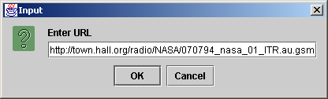
Fig. 22.1 Playing media with interface Player (Part 8).
Line 241
Line 244
Lines 249-253
Line 251
Line 252
239
240 // ensure valid layout of frame
241 validate();
242
243 // start playing media
244 player.start();
245
246 } // end prefetchComplete method
247
248 // if end of media, reset to beginning, stop play
249 public void endOfMedia( EndOfMediaEvent mediaEndEvent )
250 {
251 player.setMediaTime( new Time( 0 ) );
252 player.stop();
253 }
254
255 } // end PlayerEventHandler inner class
256
257 // execute application
258 public static void main( String args[] )
259 {
260 SimplePlayer testPlayer = new SimplePlayer();
261
262 testPlayer.setSize( 300, 300 );
263 testPlayer.setLocation( 300, 300 );
264 testPlayer.setDefaultCloseOperation( EXIT_ON_CLOSE );
265 testPlayer.setVisible( true );
266 }
267
268 } // end class SimplePlayer
Invoke method validate to ensure proper frame layout
Invoke method start to play media
Method endOfMedia resets media to beginning when EndOfMediaEvent event generated
Invoke method setMediaTime to set time to 0
Invoke method stop to stop player

Slide 12
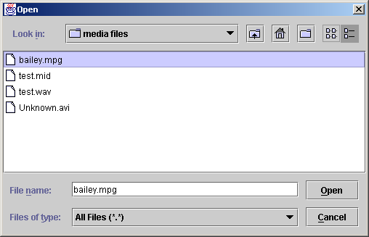
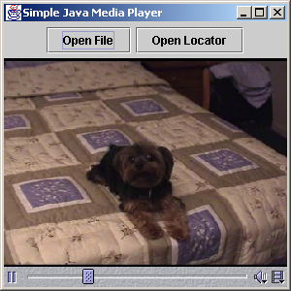
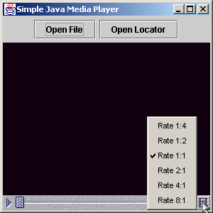
Fig. 22.1 Playing media with interface Player (Part 9).
Program Output

Slide 13
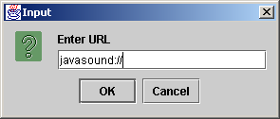

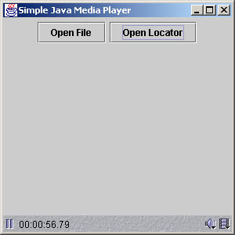
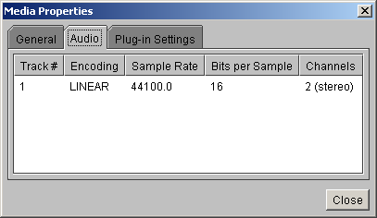
Fig. 22.1 Playing media with interface Player (Part 10).
Program Output

Slide 14
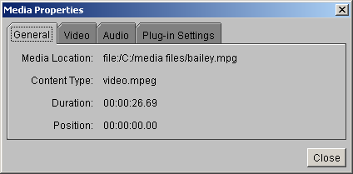
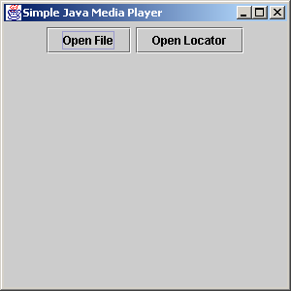
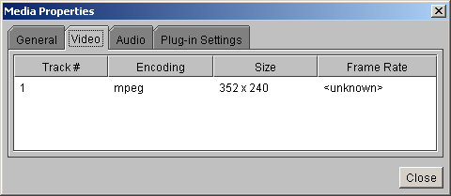
Fig. 22.1 Playing media with interface Player (Part 11).
Program Output

Slide 15
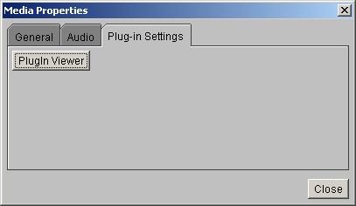
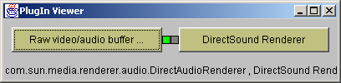
Fig. 22.1 Playing media with interface Player (Part 12).
Program Output

Slide 16
22.3 Formatting and Saving Captured Media
Capture devices
  Microphones and video cameras
  JMF converts analog signal to digital media

Slide 17
CapturePlayer.java
Lines 13-16
Line 17
Line 28
Line 31
Line 34
1 // Fig. 22.2: CapturePlayer.java
2 // Presents and saves captured media
3
4 // Java core packages
5 import java.awt.*;
6 import java.awt.event.*;
7 import java.io.*;
8 import java.util.*;
9
10 // Java extension packages
11 import javax.swing.*;
12 import javax.swing.event.*;
13 import javax.media.*;
14 import javax.media.protocol.*;
15 import javax.media.format.*;
16 import javax.media.control.*;
17 import javax.media.datasink.*;
18
19 public class CapturePlayer extends JFrame {
20
21 // capture and save button
22 private JButton captureButton;
23
24 // component for save capture GUI
25 private Component saveProgress;
26
27 // formats of device's media, user-chosen format
28 private Format formats[], selectedFormat;
29
30 // controls of device's media formats
31 private FormatControl formatControls[];
32
33 // specification information of device
34 private CaptureDeviceInfo deviceInfo;
35
Import JMF extension packages for media control and device formatting
Import JMF package for outputting formatted data
Array formats contains references to all Formats supported by a capture device
Array formatControls contains controls for each format supported by device
Object deviceInfo contains information about capture device

Slide 18
CapturePlayer.java
Line 40
Line 43
Line 46
Line 62
36 // vector containing all devices' information
37 private Vector deviceList;
38
39 // input and output data sources
40 private DataSource inSource, outSource;
41
42 // file writer for captured media
43 private DataSink dataSink;
44
45 // processor to render and save captured media
46 private Processor processor;
47
48 // constructor for CapturePlayer
49 public CapturePlayer()
50 {
51 super( "Capture Player" );
52
53 // panel containing buttons
54 JPanel buttonPanel = new JPanel();
55 getContentPane().add( buttonPanel );
56
57 // button for accessing and initializing capture devices
58 captureButton = new JButton( "Capture and Save File" );
59 buttonPanel.add( captureButton, BorderLayout.CENTER );
60
61 // register an ActionListener for captureButton events
62 captureButton.addActionListener( new CaptureHandler() );
63
64 // turn on light rendering to enable compatibility
65 // with lightweight GUI components
66 Manager.setHint( Manager.LIGHTWEIGHT_RENDERER,
67 Boolean.TRUE );
68
69 // register a WindowListener to frame events
70 addWindowListener(
Declare data input and output objects inSource and outSource
Object dataSink writes captured media to a file
Object processor controls and processes flow of media data
Register ActionListener for captureButton events

Slide 19
CapturePlayer.java
Lines 90-173
Lines 93-171
Lines 96-97
71
72 // anonymous inner class to handle WindowEvents
73 new WindowAdapter() {
74
75 // dispose processor
76 public void windowClosing(
77 WindowEvent windowEvent )
78 {
79 if ( processor != null )
80 processor.close();
81 }
82
83 } // end WindowAdapter
84
85 ); // end call to method addWindowListener
86
87 } // end constructor
88
89 // action handler class for setting up device
90 private class CaptureHandler implements ActionListener {
91
92 // initialize and configure capture device
93 public void actionPerformed( ActionEvent actionEvent )
94 {
95 // put available devices' information into vector
96 deviceList =
97 CaptureDeviceManager.getDeviceList( null );
98
99 // if no devices found, display error message
100 if ( ( deviceList == null ) ||
101 ( deviceList.size() == 0 ) ) {
102
103 showErrorMessage( "No capture devices found!" );
104
105 return;
Inner class CaptureHandler sets up device
Method actionPerformed initializes and configures capture device
Method getDeviceList returns a complete list of available capture devices

Slide 20
CapturePlayer.java
Lines 109-119
Lines 122-123
Lines 129-130
Line 132
Lines 135-136
106 }
107
108 // array of device names
109 String deviceNames[] = new String[ deviceList.size() ];
110
111 // store all device names into array of
112 // string for display purposes
113 for ( int i = 0; i < deviceList.size(); i++ ){
114
115 deviceInfo =
116 ( CaptureDeviceInfo ) deviceList.elementAt( i );
117
118 deviceNames[ i ] = deviceInfo.getName();
119 }
120
121 // get vector index of selected device
122 int selectDeviceIndex =
123 getSelectedDeviceIndex( deviceNames );
124
125 if ( selectDeviceIndex == -1 )
126 return;
127
128 // get device information of selected device
129 deviceInfo = ( CaptureDeviceInfo )
130 deviceList.elementAt( selectDeviceIndex );
131
132 formats = deviceInfo.getFormats();
133
134 // if previous capture device opened, disconnect it
135 if ( inSource != null )
136 inSource.disconnect();
137
138 // obtain device and set its format
139 try {
140
Copy names of all capture devices into a String array for display purposes
Call method getSelectedDeviceIndex to get vector index of selected device
Get device information of selected device
Call method getFormats to display format information
Call method disconnect if previous capture device open

Slide 21
CapturePlayer.java
Lines 142-143
Lines 146-147
Line 150
Line 157
141 // create data source from MediaLocator of device
142 inSource = Manager.createDataSource(
143 deviceInfo.getLocator() );
144
145 // get format setting controls for device
146 formatControls = ( ( CaptureDevice )
147 inSource ).getFormatControls();
148
149 // get user's desired device format setting
150 selectedFormat = getSelectedFormat( formats );
151
152 if ( selectedFormat == null )
153 return;
154
155 setDeviceFormat( selectedFormat );
156
157 captureSaveFile();
158
159 } // end try
160
161 // unable to find DataSource from MediaLocator
162 catch ( NoDataSourceException noDataException ) {
163 noDataException.printStackTrace();
164 }
165
166 // device connection error
167 catch ( IOException ioException ) {
168 ioException.printStackTrace();
169 }
170
171 } // end method actionPerformed
172
173 } // end inner class CaptureHandler
174
Create data source from MediaLocator of device
Call method getFormatControls to get format settings controls for device
Call method getSelectedFormat to get user’s device format setting
Call method captureSaveFile to save captured data in a file

Slide 22
CapturePlayer.java
Lines 176-192
Lines 194-210
Lines 197-201
175 // set output format of device-captured media
176 public void setDeviceFormat( Format currentFormat )
177 {
178 // set desired format through all format controls
179 for ( int i = 0; i < formatControls.length; i++ ) {
180
181 // make sure format control is configurable
182 if ( formatControls[ i ].isEnabled() ) {
183
184 formatControls[ i ].setFormat( currentFormat );
185
186 System.out.println (
187 "Presentation output format currently set as " +
188 formatControls[ i ].getFormat() );
189 }
190
191 } // end for loop
192 }
193
194 // get selected device vector index
195 public int getSelectedDeviceIndex( String[] names )
196 {
197 // get device name from dialog box of device choices
198 String name = ( String ) JOptionPane.showInputDialog(
199 this, "Select a device:", "Device Selection",
200 JOptionPane.QUESTION_MESSAGE,
201 null, names, names[ 0 ] );
202
203 // if format selected, get index of name in array names
204 if ( name != null )
205 return Arrays.binarySearch( names, name );
206
207 // else return bad selection value
208 else
209 return -1;
Method setDeviceFormat sets output format of captured media
Method getSelectedDeviceIndex gets selected device vector index
Call method showInputDialog to display dialog box of device choices

Slide 23
CapturePlayer.java
Lines 213-219
Lines 221-226
Lines 229-242
210 }
211
212 // return user-selected format for device
213 public Format getSelectedFormat( Format[] showFormats )
214 {
215 return ( Format ) JOptionPane.showInputDialog( this,
216 "Select a format: ", "Format Selection",
217 JOptionPane.QUESTION_MESSAGE,
218 null, showFormats, null );
219 }
220
221 // pop up error messages
222 public void showErrorMessage( String error )
223 {
224 JOptionPane.showMessageDialog( this, error, "Error",
225 JOptionPane.ERROR_MESSAGE );
226 }
227
228 // get desired file for saved captured media
229 public File getSaveFile()
230 {
231 JFileChooser fileChooser = new JFileChooser();
232
233 fileChooser.setFileSelectionMode(
234 JFileChooser.FILES_ONLY );
235 int result = fileChooser.showSaveDialog( this );
236
237 if ( result == JFileChooser.CANCEL_OPTION )
238 return null;
239
240 else
241 return fileChooser.getSelectedFile();
242 }
243
Method getSelectedFormat returns user-selected format for device
Method getSaveFile gets chosen file for saved captured media
Method getSaveFile gets desired file for saved captured media

Slide 24
CapturePlayer.java
Lines 245-262
Lines 254-261
Lines 265-322
Line 268
Line 270
Lines 273-274
244 // show saving monitor of captured media
245 public void showSaveMonitor()
246 {
247 // show saving monitor dialog
248 int result = JOptionPane.showConfirmDialog( this,
249 saveProgress, "Save capture in progress...",
250 JOptionPane.DEFAULT_OPTION,
251 JOptionPane.INFORMATION_MESSAGE );
252
253 // terminate saving if user presses "OK" or closes dialog
254 if ( ( result == JOptionPane.OK_OPTION ) ||
255 ( result == JOptionPane.CLOSED_OPTION ) ) {
256
257 processor.stop();
258 processor.close();
259
260 System.out.println ( "Capture closed." );
261 }
262 }
263
264 // process captured media and save to file
265 public void captureSaveFile()
266 {
267 // array of desired saving formats supported by tracks
268 Format outFormats[] = new Format[ 1 ];
269
270 outFormats[ 0 ] = selectedFormat;
271
272 // file output format
273 FileTypeDescriptor outFileType =
274 new FileTypeDescriptor( FileTypeDescriptor.QUICKTIME );
275
276 // set up and start processor and monitor capture
277 try {
278
Method showSaveMonitor shows a saving monitor for captured media
Terminate save if user presses OK or closes dialog box
Method captureSaveFile processes captured media and saves it to file
Create a new descriptor in Quicktime format
Create array of possible formats of each track of media
Set default format to first element of array

Slide 25
CapturePlayer.java
Lines 282-284
Line 287
Lines 294-296
Line 299
Line 301
279 // create processor from processor model
280 // of specific data source, track output formats,
281 // and file output format
282 processor = Manager.createRealizedProcessor(
283 new ProcessorModel( inSource, outFormats,
284 outFileType ) );
285
286 // try to make a data writer for media output
287 if ( !makeDataWriter() )
288 return;
289
290 // call start on processor to start captured feed
291 processor.start();
292
293 // get monitor control for capturing and encoding
294 MonitorControl monitorControl =
295 ( MonitorControl ) processor.getControl(
296 "javax.media.control.MonitorControl" );
297
298 // get GUI component of monitoring control
299 saveProgress = monitorControl.getControlComponent();
300
301 showSaveMonitor();
302
303 } // end try
304
305 // no processor could be found for specific
306 // data source
307 catch ( NoProcessorException processorException ) {
308 processorException.printStackTrace();
309 }
310
Instantiate a new Processor with specific data source, track output formats, and file output format
Invoke method makeDataWriter to create a DataSink object that can save file
Get monitor control for capturing and encoding
Invoke method getControlComponents to get GUI component of monitoring controls
Call method showSaveMonitor to display save monitor dialog

Slide 26
CapturePlayer.java
Lines 325-399
Lines 327-330
Line 333
Lines 344-345
311 // unable to realize through
312 // createRealizedProcessor method
313 catch ( CannotRealizeException realizeException ) {
314 realizeException.printStackTrace();
315 }
316
317 // device connection error
318 catch ( IOException ioException ) {
319 ioException.printStackTrace();
320 }
321
322 } // end method captureSaveFile
323
324 // method initializing media file writer
325 public boolean makeDataWriter()
326 {
327 File saveFile = getSaveFile();
328
329 if ( saveFile == null )
330 return false;
331
332 // get output data source from processor
333 outSource = processor.getDataOutput();
334
335 if ( outSource == null ) {
336 showErrorMessage( "No output from processor!" );
337 return false;
338 }
339
340 // start data writing process
341 try {
342
343 // create new MediaLocator from saveFile URL
344 MediaLocator saveLocator =
345 new MediaLocator ( saveFile.toURL() );
Method makeDataWriter initializes media file writer
Invoke method getSaveFile to get File object to save to
Invoke method getDataOutput to get output data source
Create new MediaLocator for saveFile URL

Slide 27
CapturePlayer.java
Lines 349-350
Lines 353-369
Lines 359-365
Lines 372-373
346
347 // create DataSink from output data source
348 // and user-specified save destination file
349 dataSink = Manager.createDataSink(
350 outSource, saveLocator );
351
352 // register a DataSinkListener for DataSinkEvents
353 dataSink.addDataSinkListener(
354
355 // anonymous inner class to handle DataSinkEvents
356 new DataSinkListener () {
357
358 // if end of media, close data writer
359 public void dataSinkUpdate(
360 DataSinkEvent dataEvent )
361 {
362 // if capturing stopped, close DataSink
363 if ( dataEvent instanceof EndOfStreamEvent )
364 dataSink.close();
365 }
366
367 } // end DataSinkListener
368
369 ); // end call to method addDataSinkListener
370
371 // start saving
372 dataSink.open();
373 dataSink.start();
374
375 } // end try
376
Create dataSink object from output data source and save file
Register a DataSinkListener for DataSinkEvents
Method dataSinkUpdate called when DataSinkEvent occurs
Open dataSink and save file

Slide 28
CapturePlayer.java
377 // DataSink could not be found for specific
378 // save file and data source
379 catch ( NoDataSinkException noDataSinkException ) {
380 noDataSinkException.printStackTrace();
381 return false;
382 }
383
384 // violation while accessing MediaLocator
385 // destination
386 catch ( SecurityException securityException ) {
387 securityException.printStackTrace();
388 return false;
389 }
390
391 // problem opening and starting DataSink
392 catch ( IOException ioException ) {
393 ioException.printStackTrace();
394 return false;
395 }
396
397 return true;
398
399 } // end method makeDataWriter
400
401 // main method
402 public static void main( String args[] )
403 {
404 CapturePlayer testPlayer = new CapturePlayer();
405

Slide 29

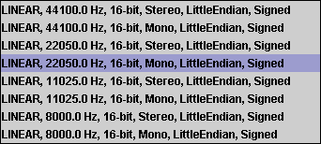
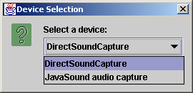
CapturePlayer.java
Program Output
406 testPlayer.setSize( 200, 70 );
407 testPlayer.setLocation( 300, 300 );
408 testPlayer.setDefaultCloseOperation( EXIT_ON_CLOSE );
409 testPlayer.setVisible( true );
410 }
411
412 } // end class CapturePlayer

Slide 30
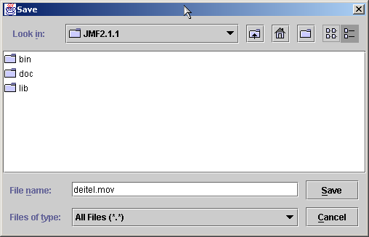
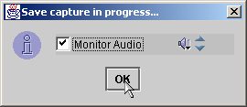
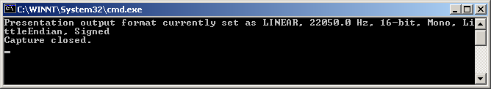
CapturePlayer.java
Program Output

Slide 31
22.4 RTP Streaming
Streaming media
  Transfer data in a continuous stream of bytes
  Allows client to view part of media while rest downloads
JMF streaming media package
  Uses Real-Time Transfer Protocol (RTF)
    Industry standard for streaming media
    Designed specifically for real-time media data

Slide 32
RTPServer.java
1 // Fig. 22.3: RTPServer.java
2 // Provides configuration and sending capabilities
3 // for RTP-supported media files
4
5 // Java core packages
6 import java.io.*;
7 import java.net.*;
8
9 // Java extension packages
10 import javax.media.*;
11 import javax.media.protocol.*;
12 import javax.media.control.*;
13 import javax.media.rtp.*;
14 import javax.media.format.*;
15
16 public class RTPServer {
17
18 // IP address, file or medialocator name, port number
19 private String ipAddress, fileName;
20 private int port;
21
22 // processor controlling data flow
23 private Processor processor;
24
25 // data output from processor to be sent
26 private DataSource outSource;
27
28 // media tracks' configurable controls
29 private TrackControl tracks[];
30
31 // RTP session manager
32 private RTPManager rtpManager[];
33

Slide 33
RTPServer.java
Lines 35-40
Lines 44-86
Line 47
Line 58
Lines 62-63
Line 68
34 // constructor for RTPServer
35 public RTPServer( String locator, String ip, int portNumber )
36 {
37 fileName = locator;
38 port = portNumber;
39 ipAddress = ip;
40 }
41
42 // initialize and set up processor
43 // return true if successful, false if not
44 public boolean beginSession()
45 {
46 // get MediaLocator from specific location
47 MediaLocator mediaLocator = new MediaLocator( fileName );
48
49 if ( mediaLocator == null ) {
50 System.err.println(
51 "No MediaLocator found for " + fileName );
52
53 return false;
54 }
55
56 // create processor from MediaLocator
57 try {
58 processor = Manager.createProcessor( mediaLocator );
59
60 // register a ControllerListener for processor
61 // to listen for state and transition events
62 processor.addControllerListener(
63 new ProcessorEventHandler() );
64
65 System.out.println( "Processor configuring..." );
66
67 // configure processor before setting it up
68 processor.configure();
Constructor takes media location, IP address and port number as arguments
Method beginSession sets up Processor that controls data flow
Initialize mediaLocator with fileName
Create processor for data specified by mediaLocator
Invoke method configure to place processor in configuring state
Register a ControllerListener to listen for state and transition events

Slide 34
RTPServer.java
Lines 89-127
Lines 94-104
Line 99
Line 103
69 }
70
71 // source connection error
72 catch ( IOException ioException ) {
73 ioException.printStackTrace();
74 return false;
75 }
76
77 // exception thrown when no processor could
78 // be found for specific data source
79 catch ( NoProcessorException noProcessorException ) {
80 noProcessorException.printStackTrace();
81 return false;
82 }
83
84 return true;
85
86 } // end method beginSession
87
88 // ControllerListener handler for processor
89 private class ProcessorEventHandler
90 extends ControllerAdapter {
91
92 // set output format and realize
93 // configured processor
94 public void configureComplete(
95 ConfigureCompleteEvent configureCompleteEvent )
96 {
97 System.out.println( "\nProcessor configured." );
98
99 setOutputFormat();
100
101 System.out.println( "\nRealizing Processor...\n" );
102
103 processor.realize();
Private class ProcessEventHandler controls media setup as processor changes states
Method configureComplete invoked when ConfigureCompleteEvent occurs
Invoke method setOutputFormat to set output format
Invoke method realize to realize processor

Slide 35
RTPServer.java
Lines 107-118
Lines 130-175
Lines 133-134
Line 137
104 }
105
106 // start sending when processor is realized
107 public void realizeComplete(
108 RealizeCompleteEvent realizeCompleteEvent )
109 {
110 System.out.println(
111 "\nInitialization successful for " + fileName );
112
113 if ( transmitMedia() == true )
114 System.out.println( "\nTransmission setup OK" );
115
116 else
117 System.out.println( "\nTransmission failed." );
118 }
119
120 // stop RTP session when there is no media to send
121 public void endOfMedia( EndOfMediaEvent mediaEndEvent )
122 {
123 stopTransmission();
124 System.out.println ( "Transmission completed." );
125 }
126
127 } // end inner class ProcessorEventHandler
128
129 // set output format of all tracks in media
130 public void setOutputFormat()
131 {
132 // set output content type to RTP capable format
133 processor.setContentDescriptor(
134 new ContentDescriptor( ContentDescriptor.RAW_RTP ) );
135
136 // get all track controls of processor
137 tracks = processor.getTrackControls();
138
Method realizeComplete invoked when RealizeCompleteEvent occurs
Method setOutputFormat sets output format of all tracks in media
Invoke method setContentDescriptor on processor object
Invoke method getTrackControls to get controls for processor

Slide 36
RTPServer.java
Lines 144-173
139 // supported RTP formats of a track
140 Format rtpFormats[];
141
142 // set each track to first supported RTP format
143 // found in that track
144 for ( int i = 0; i < tracks.length; i++ ) {
145
146 System.out.println( "\nTrack #" +
147 ( i + 1 ) + " supports " );
148
149 if ( tracks[ i ].isEnabled() ) {
150
151 rtpFormats = tracks[ i ].getSupportedFormats();
152
153 // if supported formats of track exist,
154 // display all supported RTP formats and set
155 // track format to be first supported format
156 if ( rtpFormats.length > 0 ) {
157
158 for ( int j = 0; j < rtpFormats.length; j++ )
159 System.out.println( rtpFormats[ j ] );
160
161 tracks[ i ].setFormat( rtpFormats[ 0 ] );
162
163 System.out.println ( "Track format set to " +
164 tracks[ i ].getFormat() );
165 }
166
167 else
168 System.err.println (
169 "No supported RTP formats for track!" );
170
171 } // end if
172
173 } // end for loop
Set each track to first supported RTP format found in that track

Slide 37
RTPServer.java
Lines 178-271
Line 180
Line 189
Line 192
Line 195
Lines 201-248
Line 207
174
175 } // end method setOutputFormat
176
177 // send media with boolean success value
178 public boolean transmitMedia()
179 {
180 outSource = processor.getDataOutput();
181
182 if ( outSource == null ) {
183 System.out.println ( "No data source from media!" );
184
185 return false;
186 }
187
188 // rtp stream managers for each track
189 rtpManager = new RTPManager[ tracks.length ];
190
191 // destination and local RTP session addresses
192 SessionAddress localAddress, remoteAddress;
193
194 // RTP stream being sent
195 SendStream sendStream;
196
197 // IP address
198 InetAddress ip;
199
200 // initialize transmission addresses and send out media
201 try {
202
203 // transmit every track in media
204 for ( int i = 0; i < tracks.length; i++ ) {
205
206 // instantiate a RTPManager
207 rtpManager[ i ] = RTPManager.newInstance();
208
Method transmitMedia creates structures needed to transmit media
Obtain DataSource from processor
Create array of RTPManagers to control sessions
The try block sends out each track as an RTP stream
Declare destination and local RTP SessionAddresses
Invoke method newInstance to instantiate a RTPManager
Object sendStream performs the RTP streaming

Slide 38
RTPServer.java
Line 211
Lines 218-219
Line 222
Line 225
Line 228
Lines 234-235
Line 238
209 // add 2 to specify next control port number;
210 // (RTP Session Manager uses 2 ports)
211 port += ( 2 * i );
212
213 // get IP address of host from ipAddress string
214 ip = InetAddress.getByName( ipAddress );
215
216 // encapsulate pair of IP addresses for control and
217 // data with 2 ports into local session address
218 localAddress = new SessionAddress(
219 ip.getLocalHost(), port );
220
221 // get remoteAddress session address
222 remoteAddress = new SessionAddress( ip, port );
223
224 // initialize the session
225 rtpManager[ i ].initialize( localAddress );
226
227 // open RTP session for destination
228 rtpManager[ i ].addTarget( remoteAddress );
229
230 System.out.println( "\nStarted RTP session: "
231 + ipAddress + " " + port);
232
233 // create send stream in RTP session
234 sendStream =
235 rtpManager[ i ].createSendStream( outSource, i );
236
237 // start sending the stream
238 sendStream.start();
239
240 System.out.println( "Transmitting Track #" +
241 ( i + 1 ) + " ... " );
242
243 } // end for loop
Increment port number variable
Instantiate a new localAddress
Instantiate client session address
Invoke method initialize to initialize session
Invoke method addTarget to open RTP session
Invoke method createSendStream to create RTP send stream
Invoke method start to start sending the stream

Slide 39
RTPServer.java
Line 246
Lines 274-303
244
245 // start media feed
246 processor.start();
247
248 } // end try
249
250 // unknown local or unresolvable remote address
251 catch ( InvalidSessionAddressException addressError ) {
252 addressError.printStackTrace();
253 return false;
254 }
255
256 // DataSource connection error
257 catch ( IOException ioException ) {
258 ioException.printStackTrace();
259 return false;
260 }
261
262 // format not set or invalid format set on stream source
263 catch ( UnsupportedFormatException formatException ) {
264 formatException.printStackTrace();
265 return false;
266 }
267
268 // transmission initialized successfully
269 return true;
270
271 } // end method transmitMedia
272
273 // stop transmission and close resources
274 public void stopTransmission()
275 {
276 if ( processor != null ) {
277
Invoke start method to start media feed
Method stopTransmission stops and closes Processor

Slide 40
RTPServer.java
Lines 279-282
Lines 292-293
Line 296
278 // stop processor
279 processor.stop();
280
281 // dispose processor
282 processor.close();
283
284 if ( rtpManager != null )
285
286 // close destination targets
287 // and dispose RTP managers
288 for ( int i = 0; i < rtpManager.length; i++ ) {
289
290 // close streams to all destinations
291 // with a reason for termination
292 rtpManager[ i ].removeTargets(
293 "Session stopped." );
294
295 // release RTP session resources
296 rtpManager[ i ].dispose();
297 }
298
299 } // end if
300
301 System.out.println ( "Transmission stopped." );
302
303 } // end method stopTransmission
304
305 } // end class RTPServer
Stop and dispose of processor for media
Invoke method removeTargets to close streams to a target
Invoke method dispose to release RTP session resources

Slide 41
RTPServerTest1.java
Lines 18-20
Lines 26-67
1 // Fig. 22.4: RTPServerTest.java
2 // Test class for RTPServer
3
4 // Java core packages
5 import java.awt.event.*;
6 import java.io.*;
7 import java.net.*;
8
9 // Java extension packages
10 import javax.swing.*;
11
12 public class RTPServerTest extends JFrame {
13
14 // object handling RTP streaming
15 private RTPServer rtpServer;
16
17 // media sources and destination locations
18 private int port;
19 private String ip, mediaLocation;
20 private File mediaFile;
21
22 // GUI buttons
23 private JButton transmitFileButton, transmitUrlButton;
24
25 // constructor for RTPServerTest
26 public RTPServerTest()
27 {
28 super( "RTP Server Test" );
29
30 // register a WindowListener for frame events
31 addWindowListener(
32
33 // anonymous inner class to handle WindowEvents
34 new WindowAdapter() {
35
IP addresses and port numbers
Constructor sets up GUI

Slide 42
RTPServerTest1.java
36 public void windowClosing(
37 WindowEvent windowEvent )
38 {
39 if ( rtpServer != null )
40 rtpServer.stopTransmission();
41 }
42
43 } // end WindowAdpater
44
45 ); // end call to method addWindowListener
46
47 // panel containing button GUI
48 JPanel buttonPanel = new JPanel();
49 getContentPane().add( buttonPanel );
50
51 // transmit file button GUI
52 transmitFileButton = new JButton( "Transmit File" );
53 buttonPanel.add( transmitFileButton );
54
55 // register ActionListener for transmitFileButton events
56 transmitFileButton.addActionListener(
57 new ButtonHandler() );
58
59 // transmit URL button GUI
60 transmitUrlButton = new JButton( "Transmit Media" );
61 buttonPanel.add( transmitUrlButton );
62
63 // register ActionListener for transmitURLButton events
64 transmitUrlButton.addActionListener(
65 new ButtonHandler() );
66
67 } // end constructor
68

Slide 43
RTPServerTest1.java
Lines 70-129
Private class ButtonHandler handles button events
69 // inner class handles transmission button events
70 private class ButtonHandler implements ActionListener {
71
72 // open and try to send file to user-input destination
73 public void actionPerformed( ActionEvent actionEvent )
74 {
75 // if transmitFileButton invoked, get file URL string
76 if ( actionEvent.getSource() == transmitFileButton ) {
77
78 mediaFile = getFile();
79
80 if ( mediaFile != null )
81
82 // obtain URL string from file
83 try {
84 mediaLocation = mediaFile.toURL().toString();
85 }
86
87 // file path unresolvable
88 catch ( MalformedURLException badURL ) {
89 badURL.printStackTrace();
90 }
91
92 else
93 return;
94
95 } // end if
96
97 // else transmitMediaButton invoked, get location
98 else
99 mediaLocation = getMediaLocation();
100
101 if ( mediaLocation == null )
102 return;
103

Slide 44
RTPServerTest1.java
Lines 132-146
104 // get IP address
105 ip = getIP();
106
107 if ( ip == null )
108 return;
109
110 // get port number
111 port = getPort();
112
113 // check for valid positive port number and input
114 if ( port <= 0 ) {
115
116 if ( port != -999 )
117 System.err.println( "Invalid port number!" );
118
119 return;
120 }
121
122 // instantiate new RTP streaming server
123 rtpServer = new RTPServer( mediaLocation, ip, port );
124
125 rtpServer.beginSession();
126
127 } // end method actionPeformed
128
129 } // end inner class ButtonHandler
130
131 // get file from computer
132 public File getFile()
133 {
134 JFileChooser fileChooser = new JFileChooser();
135
136 fileChooser.setFileSelectionMode(
137 JFileChooser.FILES_ONLY );
138
Method getFile gets the file from the computer

Slide 45
RTPServerTest1.java
Lines 149-161
Lines 164-176
Method getMediaLocation gets media location from user
139 int result = fileChooser.showOpenDialog( this );
140
141 if ( result == JFileChooser.CANCEL_OPTION )
142 return null;
143
144 else
145 return fileChooser.getSelectedFile();
146 }
147
148 // get media location from user
149 public String getMediaLocation()
150 {
151 String input = JOptionPane.showInputDialog(
152 this, "Enter MediaLocator" );
153
154 // if user presses OK with no input
155 if ( input != null && input.length() == 0 ) {
156 System.err.println( "No input!" );
157 return null;
158 }
159
160 return input;
161 }
162
163 // method getting IP string from user
164 public String getIP()
165 {
166 String input = JOptionPane.showInputDialog(
167 this, "Enter IP Address: " );
168
169 // if user presses OK with no input
170 if ( input != null && input.length() == 0 ) {
171 System.err.println( "No input!" );
172 return null;
173 }
Method getIP gets IP address string form user

Slide 46
RTPServerTest1.java
Lines 179-197
174
175 return input;
176 }
177
178 // get port number
179 public int getPort()
180 {
181 String input = JOptionPane.showInputDialog(
182 this, "Enter Port Number: " );
183
184 // return flag value if user clicks OK with no input
185 if ( input != null && input.length() == 0 ) {
186 System.err.println( "No input!" );
187 return -999;
188 }
189
190 // return flag value if user clicked CANCEL
191 if ( input == null )
192 return -999;
193
194 // else return input
195 return Integer.parseInt( input );
196
197 } // end method getPort
198
199 // execute application
200 public static void main( String args[] )
201 {
202 RTPServerTest serverTest = new RTPServerTest();
203
204 serverTest.setSize( 250, 70 );
205 serverTest.setLocation( 300, 300 );
206 serverTest.setDefaultCloseOperation( EXIT_ON_CLOSE );
207 serverTest.setVisible( true );
208 }
Method getPort gets port number from user

Slide 47

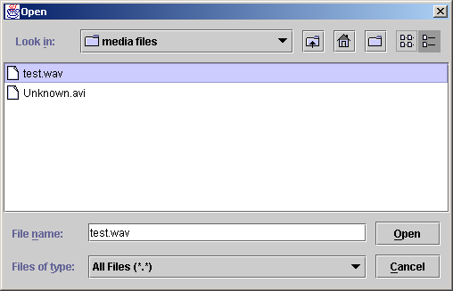
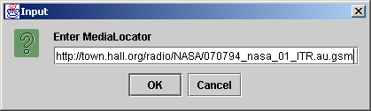
RTPServerTest1.java
Program output
209
210 } // end class RTPServerTest

Slide 48
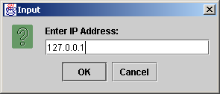
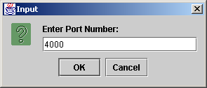
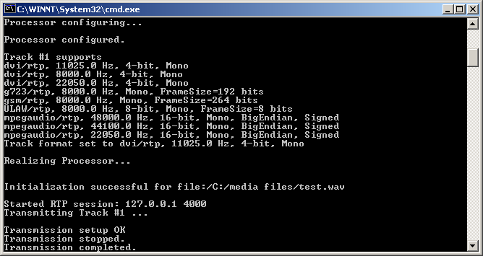
RTPServerTest1.java
Program output

Slide 49
22.5 Java Sound
Sound common in today’s applications
Java Sound API
  Allows sound to be incorporated into Java applications

Slide 50
22.6 Playing Sampled Audio
Introduces javax.sound.sampled package
  Plays popular music formats
  Provides a line through which audio data flows

Slide 51
ClipPlayer.java
Line 10
Lines 25-28
1 // Fig. 22.5: ClipPlayer.java
2 // Plays sound clip files of type WAV, AU, AIFF
3
4 // Java core packages
5 import java.io.*;
6
7 // Java extension packages
8 import javax.sound.sampled.*;
9
10 public class ClipPlayer implements LineListener {
11
12 // audio input stream
13 private AudioInputStream soundStream;
14
15 // audio sample clip line
16 private Clip clip;
17
18 // Audio clip file
19 private File soundFile;
20
21 // boolean indicating replay of audio
22 private boolean replay = false;
23
24 // constructor for ClipPlayer
25 public ClipPlayer( File audioFile )
26 {
27 soundFile = audioFile;
28 }
29
Implements LineListener
Constructor takes an audio file as an argument

Slide 52
ClipPlayer.java
Lines 31-54
Lines 35-36
Line 52
Lines 57-106
Line 63
30 // open music file, returning true if successful
31 public boolean openFile()
32 {
33 // get audio stream from file
34 try {
35 soundStream =
36 AudioSystem.getAudioInputStream( soundFile );
37 }
38
39 // audio file not supported by JavaSound
40 catch ( UnsupportedAudioFileException audioException ) {
41 audioException.printStackTrace();
42 return false;
43 }
44
45 // I/O error attempting to get stream
46 catch ( IOException ioException ) {
47 ioException.printStackTrace();
48 return false;
49 }
50
51 // invoke loadClip, returning true if load successful
52 return loadClip();
53
54 } // end method openFile
55
56 // load sound clip
57 public boolean loadClip ()
58 {
59 // get clip line for file
60 try {
61
62 // get audio format of sound file
63 AudioFormat audioFormat = soundStream.getFormat();
64
Method openFile opens a music file
Invoke method getAudioInputStream to get audio stream from file
Invoke method loadClip and return true if successful
Method loadClip loads sound clip
Invoke method getFormat to get audio format of sound file

Slide 53
ClipPlayer.java
Lines 68-69
Line 70
Line 74
Line 81
Line 84
Line 87
65 // define line information based on line type,
66 // encoding and frame sizes of audio file
67 DataLine.Info dataLineInfo = new DataLine.Info(
68 Clip.class, AudioSystem.getTargetFormats(
69 AudioFormat.Encoding.PCM_SIGNED, audioFormat ),
70 audioFormat.getFrameSize(),
71 audioFormat.getFrameSize() * 2 );
72
73 // make sure sound system supports data line
74 if ( !AudioSystem.isLineSupported( dataLineInfo ) ) {
75
76 System.err.println( "Unsupported Clip File!" );
77 return false;
78 }
79
80 // get clip line resource
81 clip = ( Clip ) AudioSystem.getLine( dataLineInfo );
82
83 // listen to clip line for events
84 clip.addLineListener( this );
85
86 // open audio clip and get required system resources
87 clip.open( soundStream );
88
89 } // end try
90
91 // line resource unavailable
92 catch ( LineUnavailableException noLineException ) {
93 noLineException.printStackTrace();
94 return false;
95 }
96
Invoke method getTargetFormats to get formats for audio file
Invoke method getFrameSize to get size of frame of audio file
Make sure sound system supports data line
Invoke method getLine to get clip line resource
Register a LineListener to listen for clip line events
Invoke method open to open audio clip

Slide 54
ClipPlayer.java
Lines 109-112
Lines 115-133
Line 120
Line 131
97 // I/O error during interpretation of audio data
98 catch ( IOException ioException ) {
99 ioException.printStackTrace();
100 return false;
101 }
102
103 // clip file loaded successfully
104 return true;
105
106 } // end method loadClip
107
108 // start playback of audio clip
109 public void play()
110 {
111 clip.start();
112 }
113
114 // line event listener method to stop or replay at clip end
115 public void update( LineEvent lineEvent )
116 {
117 // if clip reaches end, close clip
118 if ( lineEvent.getType() == LineEvent.Type.STOP &&
119 !replay )
120 close();
121
122 // if replay set, replay forever
123 else
124
125 if ( lineEvent.getType() == LineEvent.Type.STOP &&
126 replay ) {
127
128 System.out.println( "replay" );
129
130 // replay clip forever
131 clip.loop( Clip.LOOP_CONTINUOUSLY );
Method play starts audio playback
Method update listens for line events
Invoke method close if clip reaches end
Invoke method loop to play clip forever

Slide 55
ClipPlayer.java
Lines 142-148
132 }
133 }
134
135 // set replay of clip
136 public void setReplay( boolean value )
137 {
138 replay = value;
139 }
140
141 // stop and close clip, returning system resources
142 public void close()
143 {
144 if ( clip != null ) {
145 clip.stop();
146 clip.close();
147 }
148 }
149
150 } // end class ClipPlayer
Method close stops clip and recovers resources

Slide 56
ClipPlayerTest.java
1 // Fig. 22.6: ClipPlayerTest.java
2 // Test file for ClipPlayer
3
4 // Java core packages
5 import java.awt.*;
6 import java.awt.event.*;
7 import java.io.*;
8
9 // Java extension packages
10 import javax.swing.*;
11
12 public class ClipPlayerTest extends JFrame {
13
14 // object to play audio clips
15 private ClipPlayer clipPlayer;
16
17 // constructor for ClipPlayerTest
18 public ClipPlayerTest()
19 {
20 super( "Clip Player" );
21
22 // panel containing buttons
23 JPanel buttonPanel = new JPanel();
24 getContentPane().add( buttonPanel );
25
26 // open file button
27 JButton openFile = new JButton( "Open Audio Clip" );
28 buttonPanel.add( openFile, BorderLayout.CENTER );
29
30 // register ActionListener for openFile events
31 openFile.addActionListener(
32
33 // inner anonymous class to handle openFile ActionEvent
34 new ActionListener() {
35

Slide 57
ClipPlayerTest.java
Lines 37-58
Line 39
Line 44
Line 47
Line 50
Line 53
Method actionPerformed prompts user to select a file to play
36 // try to open and play an audio clip file
37 public void actionPerformed( ActionEvent event )
38 {
39 File mediaFile = getFile();
40
41 if ( mediaFile != null ) {
42
43 // instantiate new clip player with mediaFile
44 clipPlayer = new ClipPlayer( mediaFile );
45
46 // if clip player opened correctly
47 if ( clipPlayer.openFile() == true ) {
48
49 // play loaded clip
50 clipPlayer.play();
51
52 // no replay
53 clipPlayer.setReplay( false );
54 }
55
56 } // end if mediaFile
57
58 } // end actionPerformed
59
60 } // end ActionListener
61
62 ); // end call to addActionListener
63
64 } // end constructor
65
66 // get file from computer
67 public File getFile()
68 {
69 JFileChooser fileChooser = new JFileChooser();
70
Invoke method getFile to prompt user to select an audio file
Instantiate new clip player with mediaFile
Invoke method openFile to open the media file
Invoke method play to play media clip
Invoke method setReplay to set no replay

Slide 58
ClipPlayerTest.java
71 fileChooser.setFileSelectionMode(
72 JFileChooser.FILES_ONLY );
73 int result = fileChooser.showOpenDialog( this );
74
75 if ( result == JFileChooser.CANCEL_OPTION )
76 return null;
77
78 else
79 return fileChooser.getSelectedFile();
80 }
81
82 // execute application
83 public static void main( String args[] )
84 {
85 ClipPlayerTest test = new ClipPlayerTest();
86
87 test.setSize( 150, 70 );
88 test.setLocation( 300, 300 );
89 test.setDefaultCloseOperation( EXIT_ON_CLOSE );
90 test.setVisible( true );
91 }
92
93 } // end class ClipPlayerTest

Slide 59

ClipPlayer.java
Program Output

Slide 60
22.7 Musical Instrument Digital Interface (MIDI)
MIDI
  Standard format for digital music
  Can be created via digital instrument
  MIDI synthesizer
    Device that produces MIDI sounds and music
    Interpretation of MIDI data differs among synthesizers

Slide 61
22.7.1 MIDI Playback
Interpreting MIDI file contents
  MIDI data often referred to as a sequence
    MIDI composed as a sequence of events
Playing MIDI files
  Three step process
    Accessing sequencer
    Loading MIDI sequence
    Starting sequence

Slide 62
Fig. 22.7 MidiData loads MIDI files for playback.
Line 17
Line 20
1 // Fig. 22.7: MidiData.java
2 // Contains MIDI sequence information
3 // with accessor methods and MIDI playback methods
4
5 // Java core package
6 import java.io.*;
7
8 // Java extension package
9 import javax.sound.midi.*;
10
11 public class MidiData {
12
13 // MIDI track data
14 private Track track;
15
16 // player for MIDI sequences
17 private Sequencer sequencer;
18
19 // MIDI sequence
20 private Sequence sequence;
21
22 // MIDI events containing time and MidiMessages
23 private MidiEvent currentEvent, nextEvent;
24
25 // MIDI message usually containing sounding messages
26 private ShortMessage noteMessage;
27
28 // short, meta, or sysex MIDI messages
29 private MidiMessage message;
30
31 // index of MIDI event in track, command in MIDI message
32 private int eventIndex = 0, command;
33
MIDI Sequencer
MIDI Sequence

Slide 63
Fig. 22.7 MidiData loads MIDI files for playback (Part 2).
Line 41
Line 44
Line 47
Line 50
Lines 54-56
Lines 59-62
34 // method to play MIDI sequence via sequencer
35 public void play()
36 {
37 // initiate default sequencer
38 try {
39
40 // get sequencer from MidiSystem
41 sequencer = MidiSystem.getSequencer();
42
43 // open sequencer resources
44 sequencer.open();
45
46 // load MIDI into sequencer
47 sequencer.setSequence( sequence );
48
49 // play sequence
50 sequencer.start();
51 }
52
53 // MIDI resource availability error
54 catch ( MidiUnavailableException noMidiException ) {
55 noMidiException.printStackTrace();
56 }
57
58 // corrupted MIDI or invalid MIDI file encountered
59 catch ( InvalidMidiDataException badMidiException ) {
60 badMidiException.printStackTrace();
61
62 }
63
64 } // end method play
65
Obtain Sequencer to play Sequence
Open Sequencer
Load Sequence into Sequencer
Begin playing MIDI Sequence
Exception thrown if program is using same Sequencer object
Exception thrown if Sequencer detect unrecognizable Sequence

Slide 64
Fig. 22.7 MidiData loads MIDI files for playback (Part 3).
Line 77
66 // method returning adjusted tempo/resolution of MIDI
67 public int getResolution()
68 {
69 return 500 / sequence.getResolution();
70 }
71
72 // obtain MIDI and prepare track in MIDI to be accessed
73 public boolean initialize( File file )
74 {
75 // get valid MIDI from file into sequence
76 try {
77 sequence = MidiSystem.getSequence( file );
78 }
79
80 // unreadable MIDI file or unsupported MIDI
81 catch ( InvalidMidiDataException badMIDI ) {
82 badMIDI.printStackTrace();
83 return false;
84 }
85
86 // I/O error generated during file reading
87 catch ( IOException ioException ) {
88 ioException.printStackTrace();
89 return false;
90 }
91
92 return true;
93
94 } // end method initialize
95
Obtain Sequence from file

Slide 65
Fig. 22.7 MidiData loads MIDI files for playback (Part 4).
Line 100
Lines 108-114
Line 117
Line 120
96 // prepare longest track to be read and get first MIDI event
97 public boolean initializeTrack()
98 {
99 // get all tracks from sequence
100 Track tracks[] = sequence.getTracks();
101
102 if ( tracks.length == 0 ) {
103 System.err.println( "No tracks in MIDI sequence!" );
104
105 return false;
106 }
107
108 track = tracks[ 0 ];
109
110 // find longest track
111 for ( int i = 0; i < tracks.length; i++ )
112
113 if ( tracks[ i ].size() > track.size() )
114 track = tracks[ i ];
115
116 // set current MIDI event to first event in track
117 currentEvent = track.get( eventIndex );
118
119 // get MIDI message from event
120 message = currentEvent.getMessage();
121
122 // track initialization successful
123 return true;
124
125 } // end method initializeTrack
126
Obtain all Tracks in MIDI Sequence
Determine longest Track in MIDI and set it as the one to play
Obtain first MIDI event in Track
Obtain MidiMessage from MIDI event

Slide 66
Fig. 22.7 MidiData loads MIDI files for playback (Part 5).
Lines 128-133
Lines 139-140
Lines 143-144
Lines 148-155
Lines 158-168
127 // move to next event in track
128 public void goNextEvent()
129 {
130 eventIndex++;
131 currentEvent = track.get( eventIndex );
132 message = currentEvent.getMessage();
133 }
134
135 // get time interval between events
136 public int getEventDelay()
137 {
138 // first event's time interval is its duration
139 if ( eventIndex == 0 )
140 return ( int ) currentEvent.getTick();
141
142 // time difference between current and next event
143 return ( int ) ( track.get( eventIndex + 1 ).getTick() -
144 currentEvent.getTick() );
145 }
146
147 // return if track has ended
148 public boolean isTrackEnd()
149 {
150 // if eventIndex is less than track's number of events
151 if ( eventIndex + 1 < track.size() )
152 return false;
153
154 return true;
155 }
156
157 // get current ShortMessage command from event
158 public int getEventCommand()
159 {
160 if ( message instanceof ShortMessage ) {
161
Traverse each event in the Tracks
Return first MidiEvent’s time stamp as event’s duration
Return duration of MidiEvent as the time difference between two events in MIDI sequence
Provide indication of end of a track
Determine command number representing command instruction

Slide 67
Fig. 22.7 MidiData loads MIDI files for playback (Part 5).
Lines 171-176
Lines 180-183
162 // obtain MidiMessage for accessing purposes
163 noteMessage = ( ShortMessage ) message;
164 return noteMessage.getCommand();
165 }
166
167 return -1;
168 }
169
170 // get note number of current event
171 public int getNote()
172 {
173 if ( noteMessage != null )
174 return noteMessage.getData1();
175
176 return -1;
177 }
178
179 // get volume of current event
180 public int getVolume()
181 {
182 return noteMessage.getData2();
183 }
184
185 } // end class MidiData
Obtain number of note for current event
Return volume

Slide 68
22.7.2 MIDI Recording
MIDI Recording
  Transmitter sends MIDI messages to MIDI device
    MIDI device class implements interface Receiver

Slide 69
Fig. 22.8 MidiRecord enables a program to record a MIDI sequence.
Line 17
Line 20
Lines 23-26
1 // Fig. 22.8: MidiRecord.java
2 // Allows for recording and playback
3 // of synthesized MIDI
4
5 // Java core packages
6 import java.io.*;
7
8 // Java extension package
9 import javax.sound.midi.*;
10
11 public class MidiRecord {
12
13 // MIDI track
14 private Track track;
15
16 // MIDI sequencer to play and access music
17 private Sequencer sequencer;
18
19 // MIDI sequence
20 private Sequence sequence;
21
22 // receiver of MIDI events
23 private Receiver receiver;
24
25 // transmitter for transmitting MIDI messages
26 private Transmitter transmitter;
27
28 // constructor for MidiRecord
29 public MidiRecord( Transmitter transmit )
30 {
31 transmitter = transmit;
32 }
33
MIDI Sequencer
MIDI Sequence
Transmitter will send MIDI messages to Receiver

Slide 70
Fig. 22.8 MidiRecord enables a program to record a MIDI sequence (Part 2).
Lines 35-77
Line 41
Lines 48-57
34 // initialize recording sequencer, set up recording sequence
35 public boolean initialize()
36 {
37 // create empty MIDI sequence and set up sequencer wiring
38 try {
39
40 // create tempo-based sequence of 10 pulses per beat
41 sequence = new Sequence( Sequence.PPQ, 10 );
42
43 // obtain sequencer and open it
44 sequencer = MidiSystem.getSequencer();
45 sequencer.open();
46
47 // get receiver of sequencer
48 receiver = sequencer.getReceiver();
49
50 if ( receiver == null ) {
51 System.err.println(
52 "Receiver unavailable for sequencer" );
53 return false;
54 }
55
56 // set receiver for transmitter to send MidiMessages
57 transmitter.setReceiver( receiver );
58
59 makeTrack();
60 }
61
62 // invalid timing division specification for new sequence
63 catch ( InvalidMidiDataException invalidMidiException ) {
64 invalidMidiException.printStackTrace();
65 return false;
66 }
67
Set up sequencer for recording
Instantiates empty sequence (MidiRecord records data to this sequence when the transmitter connects to receiver)
Obtain recording sequencer’s Receiver and specify that Transmitter will send its messages to Receiver

Slide 71
Fig. 22.8 MidiRecord enables a program to record a MIDI sequence (Part 3).
Lines 80-88
Lines 97-115
Line 101
68 // sequencer or receiver unavailable
69 catch ( MidiUnavailableException noMidiException ) {
70 noMidiException.printStackTrace();
71 return false;
72 }
73
74 // MIDI recorder initialization successful
75 return true;
76
77 } // end method initialize
78
79 // make new empty track for sequence
80 public void makeTrack()
81 {
82 // if previous track exists, delete it first
83 if ( track != null )
84 sequence.deleteTrack( track );
85
86 // create track in sequence
87 track = sequence.createTrack();
88 }
89
90 // start playback of loaded sequence
91 public void play()
92 {
93 sequencer.start();
94 }
95
96 // start recording into sequence
97 public void startRecord()
98 {
99 // load sequence into recorder and start recording
100 try {
101 sequencer.setSequence( sequence );
102
Delete previous existing Track and create empty Track
Start recording process
Load empty Sequence into Sequencer

Slide 72
Fig. 22.8 MidiRecord enables a program to record a MIDI sequence (Part 4).
Line 104
Line 106
Line 127
Line 136
103 // set track to recording-enabled and default channel
104 sequencer.recordEnable( track, 0 );
105
106 sequencer.startRecording();
107 }
108
109 // sequence contains bad MIDI data
110 catch ( InvalidMidiDataException badMidiException ) {
111 badMidiException.printStackTrace();
112
113 }
114
115 } // end method startRecord
116
117 // stop MIDI recording
118 public void stopRecord()
119 {
120 sequencer.stopRecording();
121 }
122
123 // save MIDI sequence to file
124 public void saveSequence( File file )
125 {
126 // get all MIDI supported file types
127 int[] fileTypes = MidiSystem.getMidiFileTypes( sequence );
128
129 if ( fileTypes.length == 0 ) {
130 System.err.println( "No supported MIDI file format!" );
131 return;
132 }
133
134 // write recorded sequence into MIDI file
135 try {
136 MidiSystem.write( sequence, fileTypes[ 0 ], file );
137 }
Enable recording on Track
Start recording of MIDI events sent from Transmitter
Obtain array of MIDI file types supported by the system for writing Sequences to files
Write Sequence to specified File

Slide 73
Fig. 22.8 MidiRecord enables a program to record a MIDI sequence (Part 5).
138
139 // error writing to file
140 catch ( IOException ioException ) {
141 ioException.printStackTrace();
142 }
143
144 } // end method saveSequence
145
146 } // end class MidiRecord

Slide 74
22.7.3 MIDI Synthesis
Interface Synthesizer
  Sub-interface of MidiDevice
  Accesses default synthesizer’s:
    Sound generation
    Instruments
      instructs computer on how to make sound of specific note
    Channel resources
      MidiChannel plays different notes made by Instruments
    Sound banks.
      Container for various Instruments

Slide 75
Fig. 22.9 MidiSynthesizer can generate notes and send them to another MIDI device.
Lines 29-72
Line 34
1 // Fig. 22.9: MidiSynthesizer.java
2 // Accessing synthesizer resources
3
4 // Java extension package
5 import javax.sound.midi.*;
6
7 public class MidiSynthesizer {
8
9 // main synthesizer accesses resources
10 private Synthesizer synthesizer;
11
12 // available instruments for synthesis use
13 private Instrument instruments[];
14
15 // channels through which notes sound
16 private MidiChannel channels[];
17 private MidiChannel channel; // current channel
18
19 // transmitter for transmitting messages
20 private Transmitter transmitter;
21
22 // receiver end of messages
23 private Receiver receiver;
24
25 // short message containing sound commands, note, volume
26 private ShortMessage message;
27
28 // constructor for MidiSynthesizer
29 public MidiSynthesizer()
30 {
31 // open synthesizer, set receiver,
32 // obtain channels and instruments
33 try {
34 synthesizer = MidiSystem.getSynthesizer();
35
Acquire Synthesizer and initialize related resources
Obtain Synthesizer

Slide 76
Fig. 22.9 MidiSynthesizer can generate notes and send them to another MIDI device (Part 2).
Line 38
Lines 41-47
Line 54
Line 57
36 if ( synthesizer != null ) {
37
38 synthesizer.open();
39
40 // get transmitter of synthesizer
41 transmitter = synthesizer.getTransmitter();
42
43 if ( transmitter == null )
44 System.err.println( "Transmitter unavailable" );
45
46 // get receiver of synthesizer
47 receiver = synthesizer.getReceiver();
48
49 if ( receiver == null )
50 System.out.println( "Receiver unavailable" );
51
52 // get all available instruments in default
53 // soundbank or synthesizer
54 instruments = synthesizer.getAvailableInstruments();
55
56 // get all 16 channels from synthesizer
57 channels = synthesizer.getChannels();
58
59 // assign first channel as default channel
60 channel = channels[ 0 ];
61 }
62
63 else
64 System.err.println( "No Synthesizer" );
65 }
66
67 // synthesizer, receiver or transmitter unavailable
68 catch ( MidiUnavailableException noMidiException ) {
69 noMidiException.printStackTrace();
70 }
Open Synthesizer
Obtain Transmitter and Receiver of the Synthesizer to enable sounds to be played and recorded simultaneously
Obtain all available Instruments from Synthesizer
Obtain all 16 channels from Synthesizer

Slide 77
Fig. 22.9 MidiSynthesizer can generate notes and send them to another MIDI device (Part 3).
Lines 87-90
Lines 93-96
Lines 99-105
71
72 } // end constructor
73
74 // return available instruments
75 public Instrument[] getInstruments()
76 {
77 return instruments;
78 }
79
80 // return synthesizer's transmitter
81 public Transmitter getTransmitter()
82 {
83 return transmitter;
84 }
85
86 // sound note on through channel
87 public void midiNoteOn( int note, int volume )
88 {
89 channel.noteOn( note, volume );
90 }
91
92 // sound note off through channel
93 public void midiNoteOff( int note )
94 {
95 channel.noteOff( note );
96 }
97
98 // change to selected instrument
99 public void changeInstrument( int index )
100 {
101 Patch patch = instruments[ index ].getPatch();
102
103 channel.programChange( patch.getBank(),
104 patch.getProgram() );
105 }
Sound note
Sound note off
Allow for changing from default Instrument

Slide 78
Fig. 22.9 MidiSynthesizer can generate notes and send them to another MIDI device (Part 4).
Lines 112-119
106
107 // send custom MIDI messages through transmitter
108 public void sendMessage( int command, int note, int volume )
109 {
110 // send a MIDI ShortMessage using this method's parameters
111 try {
112 message = new ShortMessage();
113
114 // set new message of command (NOTE_ON, NOTE_OFF),
115 // note number, volume
116 message.setMessage( command, note, volume );
117
118 // send message through receiver
119 receiver.send( message, -1 );
120 }
121
122 // invalid message values set
123 catch ( InvalidMidiDataException badMidiException ) {
124 badMidiException.printStackTrace();
125 }
126
127 } // end method sendMessage
128
129 } // end class MidiSynthesizer
Create ShortMessage from parameters of method sendMessage and send message to Synthesizer’s Receiver

Slide 79
22.7.4 Class MidiDemo
MidiDemo (Fig. 22.10)
  GUI-driven “piano player” application

Slide 80
Fig. 22.10 MidiDemo provides the GUI that enables users to interact with the application.
Line 16
1 // Fig. 22.10: MidiDemo.java
2 // Simulates a musical keyboard with various
3 // instruments to play, also featuring recording, MIDI file
4 // playback and simulating MIDI playback with the keyboard
5
6 // Java core packages
7 import java.awt.*;
8 import java.awt.event.*;
9 import java.io.*;
10
11 // Java extension packages
12 import javax.swing.*;
13 import javax.swing.event.*;
14 import javax.sound.midi.*;
15
16 public class MidiDemo extends JFrame {
17
18 // recording MIDI data
19 private MidiRecord midiRecord;
20
21 // synthesize MIDI functioning
22 private MidiSynthesizer midiSynthesizer;
23
24 // MIDI data in MIDI file
25 private MidiData midiData;
26
27 // timer for simulating MIDI on piano
28 private Timer pianoTimer;
29
30 // piano keys
31 private JButton noteButton[];
32
33 // volume, tempo sliders
34 private JSlider volumeSlider, resolutionSlider;
35
Create GUI-driven MIDI demo application

Slide 81
Fig. 22.10 MidiDemo provides the GUI that enables users to interact with the application (Part 2).
36 // containers and panels holding GUI
37 private Container container;
38 private JPanel controlPanel, buttonPanel;
39
40 // instrument selector and buttons GUI
41 private JComboBox instrumentBox;
42 private JButton playButton, recordButton,
43 saveButton, pianoPlayerButton, listenButton;
44
45 // tempo, last piano key invoked, volume of MIDI
46 private int resolution, lastKeyOn = -1, midiVolume = 40;
47
48 // boolean value indicating if program is in recording mode
49 private boolean recording = false;
50
51 // first note number of first piano key, max number of keys
52 private static int FIRST_NOTE = 32, MAX_KEYS = 64;
53
54 // constructor for MidiDemo
55 public MidiDemo()
56 {
57 super( "MIDI Demo" );
58
59 container = getContentPane();
60 container.setLayout( new BorderLayout() );
61
62 // synthesizer must be instantiated to enable synthesis
63 midiSynthesizer = new MidiSynthesizer();
64
65 // make piano keys
66 makeKeys();
67
68 // add control panel to frame
69 controlPanel = new JPanel( new BorderLayout() );
70 container.add( controlPanel, BorderLayout.NORTH );

Slide 82
Fig. 22.10 MidiDemo provides the GUI that enables users to interact with the application (Part 3).
Lines 86-93
71
72 makeConfigureControls();
73
74 // add button panel to frame
75 buttonPanel = new JPanel( new GridLayout( 5, 1 ) );
76 controlPanel.add( buttonPanel, BorderLayout.EAST );
77
78 // make GUI
79 makePlaySaveButtons();
80 makeRecordButton();
81 makePianoPlayerButton();
82
83 } // end constructor
84
85 // utility method making piano keys
86 private void makeKeys()
87 {
88 // panel containing keys
89 JPanel keyPanel = new JPanel( null );
90 container.add( keyPanel, BorderLayout.CENTER );
91
92 // piano keys
93 noteButton = new JButton[ MAX_KEYS ];
94
95 // add MAX_KEYS buttons and what note they sound
96 for ( int i = 0; i < MAX_KEYS; i++ ) {
97
98 final int note = i;
99
100 noteButton[ i ] = new JButton();
101
102 // setting white keys
103 noteButton[ i ].setBackground( Color.white );
104
Create 64 JButtons that represent 64 different piano keys (when mouse hovers over a key, program sounds designated note)

Slide 83
Fig. 22.10 MidiDemo provides the GUI that enables users to interact with the application (Part 4).
Line 110
Lines 116-132
Lines 119-122
Lines 125-127
Lines 130-131
105 // set correct spacing for buttons
106 noteButton[ i ].setBounds( ( i * 11 ), 1, 11, 40 );
107 keyPanel.add( noteButton[ i ] );
108
109 // register a mouse listener for mouse events
110 noteButton[ i ].addMouseListener(
111
112 // anonymous inner class to handle mouse events
113 new MouseAdapter() {
114
115 // invoke key note when mouse touches key
116 public void mouseEntered( MouseEvent mouseEvent )
117 {
118 // if recording, send message to receiver
119 if ( recording )
120 midiSynthesizer.sendMessage(
121 ShortMessage.NOTE_ON,
122 note + FIRST_NOTE, midiVolume );
123
124 // else just sound the note
125 else
126 midiSynthesizer.midiNoteOn(
127 note + FIRST_NOTE, midiVolume );
128
129 // turn key color to blue
130 noteButton[ note ].setBackground(
131 Color.blue );
132 }
133
Register MouseListeners for each piano-key JButton
Method mouseEntered is invoked when the mouse hovers over each JButton
If program is in recording mode, access channels in MidiSynthesizer to sound note
If program is not in recording mode, send a note message to Synthesizer and to recording device
Set JButton’s background color to blue, indicating that note is being played.

Slide 84
Fig. 22.10 MidiDemo provides the GUI that enables users to interact with the application (Part 5).
Lines 135-147
Lines 158-237
Lines 165-166
134 // turn key note off when mouse leaves key
135 public void mouseExited( MouseEvent mouseEvent )
136 {
137 if ( recording )
138 midiSynthesizer.sendMessage(
139 ShortMessage.NOTE_OFF,
140 note + FIRST_NOTE, midiVolume );
141 else
142 midiSynthesizer.midiNoteOff(
143 note + FIRST_NOTE );
144
145 noteButton[ note ].setBackground(
146 Color.white );
147 }
148
149 } // end MouseAdapter
150
151 ); // end call to addMouseListener
152
153 } // end for loop
154
155 } // end method makeKeys
156
157 // set up configuration controls
158 private void makeConfigureControls()
159 {
160 JPanel configurePanel =
161 new JPanel( new GridLayout( 5, 1 ) );
162
163 controlPanel.add( configurePanel, BorderLayout.WEST );
164
165 instrumentBox = new JComboBox(
166 midiSynthesizer.getInstruments() );
167
168 configurePanel.add( instrumentBox );
Method mouseExited is invoked when mouse is no longer hovering over JButton
Setup MIDI controls, which consist of instrument selector JComboBox, user-synthesis volume changer JSlider and “piano player” tempo changer JSlider
Instantiate instrument selector JComboBox

Slide 85
Fig. 22.10 MidiDemo provides the GUI that enables users to interact with the application (Part 6).
Lines 177-182
Lines 180-181
Lines 191-192
169
170 // register an ActionListener for instrumentBox events
171 instrumentBox.addActionListener(
172
173 // anonymous inner class to handle instrument selector
174 new ActionListener() {
175
176 // change current instrument program
177 public void actionPerformed( ActionEvent event )
178 {
179 // change instrument in synthesizer
180 midiSynthesizer.changeInstrument(
181 instrumentBox.getSelectedIndex() );
182 }
183
184 } // end ActionListener
185
186 ); // end call to method addActionListener
187
188 JLabel volumeLabel = new JLabel( "volume" );
189 configurePanel.add( volumeLabel );
190
191 volumeSlider = new JSlider(
192 SwingConstants.HORIZONTAL, 5, 80, 30 );
193
194 // register a ChangeListener for slider change events
195 volumeSlider.addChangeListener(
196
197 // anonymous inner class to handle volume slider events
198 new ChangeListener() {
199
Method actionPerformed is invoked when user selects instrument
change to selected instrument program
Instantiate user-synthesis volume changer JSlider

Slide 86
Fig. 22.10 MidiDemo provides the GUI that enables users to interact with the application (Part 7).
Lines 201-204
Lines 215-216
Lines 225-228
200 // change volume
201 public void stateChanged( ChangeEvent changeEvent )
202 {
203 midiVolume = volumeSlider.getValue();
204 }
205
206 } // end class ChangeListener
207
208 ); // end call to method addChangeListener
209
210 configurePanel.add( volumeSlider );
211
212 JLabel tempLabel = new JLabel( "tempo" );
213 configurePanel.add( tempLabel );
214
215 resolutionSlider = new JSlider(
216 SwingConstants.HORIZONTAL, 1, 10, 1 );
217
218 // register a ChangeListener slider for change events
219 resolutionSlider.addChangeListener(
220
221 // anonymous inner class to handle tempo slider events
222 new ChangeListener() {
223
224 // change resolution if value changed
225 public void stateChanged( ChangeEvent changeEvent )
226 {
227 resolution = resolutionSlider.getValue();
228 }
229
230 } // end ChangeListener
231
232 ); // end call to method addChangeListener
233
Change volume when user accesses JSlider
Instantiate “piano player” tempo changer JSlider
Set tempo when user accesses JSlider

Slide 87
Fig. 22.10 MidiDemo provides the GUI that enables users to interact with the application (Part 8).
Lines 240-320
Lines 251-255
234 resolutionSlider.setEnabled( false );
235 configurePanel.add( resolutionSlider );
236
237 } // end method makeConfigureControls
238
239 // set up play and save buttons
240 private void makePlaySaveButtons()
241 {
242 playButton = new JButton( "Playback" );
243
244 // register an ActionListener for playButton events
245 playButton.addActionListener(
246
247 // anonymous inner class to handle playButton event
248 new ActionListener() {
249
250 // playback last recorded MIDI
251 public void actionPerformed( ActionEvent event )
252 {
253 if ( midiRecord != null )
254 midiRecord.play();
255 }
256
257 } // end ActionListener
258
259 ); // end call to method addActionListener
260
261 buttonPanel.add( playButton );
262 playButton.setEnabled( false );
263
264 listenButton = new JButton( "Play MIDI" );
265
266 // register an ActionListener for listenButton events
267 listenButton.addActionListener(
268
Setup Playback, Play MIDI and Save buttons.
When user presses Playback button, play recorded MIDI

Slide 88
Fig. 22.10 MidiDemo provides the GUI that enables users to interact with the application (Part 9).
Lines 273-288
Lines 275-287
269 // anonymous inner class to handle listenButton events
270 new ActionListener() {
271
272 // playback MIDI file
273 public void actionPerformed( ActionEvent event )
274 {
275 File midiFile = getFile();
276
277 if ( midiFile == null )
278 return;
279
280 midiData = new MidiData();
281
282 // prepare MIDI track
283 if ( midiData.initialize( midiFile ) == false )
284 return;
285
286 // play MIDI data
287 midiData.play();
288 }
289
290 } // end ActionListener
291
292 ); // end call to method addActionListener
293
294 buttonPanel.add( listenButton );
295
296 saveButton = new JButton( "Save MIDI" );
297
298 // register an ActionListener for saveButton events
299 saveButton.addActionListener(
300
301 // anonymous inner class to handle saveButton events
302 new ActionListener() {
303
When user presses Play MIDI button, use class MidiData to playback an opened MIDI file in its entirety
Get MIDI file specified by user, then use class MidiData to play MIDI file

Slide 89
Fig. 22.10 MidiDemo provides the GUI that enables users to interact with the application
(Part 10).
Lines 305-311
Line 323-325
Lines 334-379
304 // get save file and save recorded MIDI
305 public void actionPerformed( ActionEvent event )
306 {
307 File saveFile = getSaveFile();
308
309 if ( saveFile != null )
310 midiRecord.saveSequence( saveFile );
311 }
312
313 } // end ActionListener
314
315 ); // end call to method addActionListener
316
317 buttonPanel.add( saveButton );
318 saveButton.setEnabled( false );
319
320 } // end method makePlaySaveButtons
321
322 // make recording button
323 private void makeRecordButton()
324 {
325 recordButton = new JButton( "Record" );
326
327 // register an ActionListener for recordButton events
328 recordButton.addActionListener(
329
330 // anonymous inner class to handle recordButton events
331 new ActionListener() {
332
333 // start or stop recording
334 public void actionPerformed( ActionEvent event )
335 {
336 // record MIDI when button is "record" button
337 if ( recordButton.getText().equals("Record") ) {
338
When user presses Save button, save recorded sequence to file
Create Record button
Method action-Performed invoked when user presses Record button

Slide 90
Fig. 22.10 MidiDemo provides the GUI that enables users to interact with the application
(Part 11).
Lines 343-344
Lines 350-351
Lines 353-360
Lines 365-373
339 if ( midiRecord == null ) {
340
341 // create new instance of recorder
342 // by passing in synthesizer transmitter
343 midiRecord = new MidiRecord(
344 midiSynthesizer.getTransmitter() );
345
346 if ( midiRecord.initialize() == false )
347 return;
348 }
349
350 else
351 midiRecord.makeTrack();
352
353 midiRecord.startRecord();
354
355 // disable playback during recording
356 playButton.setEnabled( false );
357
358 // change recording button to stop
359 recordButton.setText( "Stop" );
360 recording = true;
361
362 } // end if
363
364 // stop recording when button is "stop" button
365 else {
366 midiRecord.stopRecord();
367
368 recordButton.setText( "Record" );
369 recording = false;
370
371 playButton.setEnabled( true );
372 saveButton.setEnabled( true );
373 }
Use class MidiRecord to create recorder
If a recorder has already been created, make new track for object midiRecord
When recording starts, turn the Record button into a Stop button and disable the Play MIDI button temporarily.
When users stop recording, GUI maintains state prior to that of recording (i.e., user can playback and save MIDI sequence)

Slide 91
Fig. 22.10 MidiDemo provides the GUI that enables users to interact with the application
(Part 12).
Lines 386-388
Lines 397-428
Lines 399-408
374
375 } // end method actionPerformed
376
377 } // end ActionListener
378
379 ); // end call to method addActionListener
380
381 buttonPanel.add( recordButton );
382
383 } // end method makeRecordButton
384
385 // create Piano Player button and functionality
386 private void makePianoPlayerButton()
387 {
388 pianoPlayerButton = new JButton( "Piano Player" );
389
390 // register an ActionListener for pianoPlayerButton events
391 pianoPlayerButton.addActionListener(
392
393 // anonymous inner class to handle pianoPlayerButton
394 new ActionListener() {
395
396 // initialize MIDI data and piano player timer
397 public void actionPerformed( ActionEvent event )
398 {
399 File midiFile = getFile();
400
401 if ( midiFile == null )
402 return;
403
404 midiData = new MidiData();
405
406 // prepare MIDI track
407 if ( midiData.initialize( midiFile ) == false )
408 return;
Create Piano Player button
Method actionPerformed invoked when user presses Piano Player button
Open file from file dialog box and load MIDI data from file

Slide 92
Fig. 22.10 MidiDemo provides the GUI that enables users to interact with the application
(Part 13).
Lines 410-411
Line 414
Lines 418-420
409
410 if ( midiData.initializeTrack() == false )
411 return;
412
413 // set initial resolution from MIDI
414 resolution = midiData.getResolution();
415
416 // new instance of timer for handling
417 // piano sounds and key pressing with tempo
418 pianoTimer = new Timer(
419 midiData.getEventDelay() * resolution,
420 new TimerHandler() );
421
422 listenButton.setEnabled( false );
423 pianoPlayerButton.setEnabled( false );
424 resolutionSlider.setEnabled( true );
425
426 pianoTimer.start();
427
428 } // method end actionPerformed
429
430 } // end ActionListener
431
432 ); // end call to method addActionListener
433
434 buttonPanel.add( pianoPlayerButton );
435
436 } // end method makePianoPlayerButton
437
438 // inner class handles MIDI timed events
439 private class TimerHandler implements ActionListener {
440
441 // simulate key note of event if present, jump to next
442 // event in track and set next delay interval of timer
443 // method invoked when timer reaches next event time
Obtain longest track from loaded MIDI and obtain first MIDI event message from track.
Obtain piano player’s default tempo
Instantiate Timer that plays notes at time of each MIDI event.

Slide 93
Fig. 22.10 MidiDemo provides the GUI that enables users to interact with the application
(Part 14).
Lines 447-449
Line 452
Lines 457-459
Lines 472-473
444 public void actionPerformed( ActionEvent actionEvent )
445 {
446 // if valid last key on, set it white
447 if ( lastKeyOn != -1 )
448 noteButton[ lastKeyOn ].setBackground(
449 Color.white );
450
451 noteAction();
452 midiData.goNextEvent();
453
454 // stop piano player when end of MIDI track
455 if ( midiData.isTrackEnd() == true ) {
456
457 if ( lastKeyOn != -1 )
458 noteButton[ lastKeyOn ].setBackground(
459 Color.white );
460
461 pianoTimer.stop();
462
463 listenButton.setEnabled( true );
464 pianoPlayerButton.setEnabled( true );
465 resolutionSlider.setEnabled( false );
466
467 return;
468
469 } // end if isTrackEnd
470
471 // set interval before next sounding event
472 pianoTimer.setDelay(
473 midiData.getEventDelay() * resolution );
474
475 } // end actionPerformed method
476
477 } // end inner class TimerHandler
478
When pianoTimer reaches next event, change background of last pressed piano key to white
Transition to next event in track
When pianoTimer reaches next event, change background of last pressed piano key to white
Reset Timer’s delay to next MidiEvent’s duration

Slide 94
Fig. 22.10 MidiDemo provides the GUI that enables users to interact with the application
(Part 15).
Lines 481-494
479 // determine which note to sound
480 // according to MIDI messages
481 private void noteAction()
482 {
483 // during Note On message, sound note and press key
484 if ( midiData.getEventCommand() ==
485 ShortMessage.NOTE_ON ) {
486
487 // make sure valid note is in range of keys
488 if ( ( midiData.getNote() >= FIRST_NOTE ) &&
489 ( midiData.getNote() < FIRST_NOTE + MAX_KEYS ) ) {
490
491 lastKeyOn = midiData.getNote() - FIRST_NOTE;
492
493 // set key color to red
494 noteButton[ lastKeyOn ].setBackground( Color.red );
495
496 // send and sound note through synthesizer
497 midiSynthesizer.sendMessage( 144,
498 midiData.getNote(), midiData.getVolume() );
499
500 } // end if
501
502 // else no last key pressed
503 else
504 lastKeyOn = -1;
505
506 } // end if
507
508 // receiving Note Off message will sound off note
509 // and change key color back to white
510 else
511
Sound note and change color of specific piano key

Slide 95
Fig. 22.10 MidiDemo provides the GUI that enables users to interact with the application
(Part 16).
Lines 520-521
512 // if message command is note off
513 if ( midiData.getEventCommand() ==
514 ShortMessage.NOTE_OFF ) {
515
516 if ( ( midiData.getNote() >= FIRST_NOTE ) &&
517 ( midiData.getNote() < FIRST_NOTE + MAX_KEYS ) ) {
518
519 // set appropriate key to white
520 noteButton[ midiData.getNote() -
521 FIRST_NOTE ].setBackground( Color.white );
522
523 // send note off message to receiver
524 midiSynthesizer.sendMessage( 128,
525 midiData.getNote(), midiData.getVolume() );
526 }
527
528 } // end if
529
530 } // end method noteAction
531
532 // get save file from computer
533 public File getSaveFile()
534 {
535 JFileChooser fileChooser = new JFileChooser();
536
537 fileChooser.setFileSelectionMode(
538 JFileChooser.FILES_ONLY );
539 int result = fileChooser.showSaveDialog( this );
540
541 if ( result == JFileChooser.CANCEL_OPTION )
542 return null;
543
544 else
545 return fileChooser.getSelectedFile();
546 }
Sound note off and change color of specific piano key

Slide 96
Fig. 22.10 MidiDemo provides the GUI that enables users to interact with the application
(Part 17).
547
548 // get file from computer
549 public File getFile()
550 {
551 JFileChooser fileChooser = new JFileChooser();
552
553 fileChooser.setFileSelectionMode(
554 JFileChooser.FILES_ONLY );
555 int result = fileChooser.showOpenDialog( this );
556
557 if ( result == JFileChooser.CANCEL_OPTION )
558 return null;
559
560 else
561 return fileChooser.getSelectedFile();
562 }
563
564 // execute application
565 public static void main( String args[] )
566 {
567 MidiDemo midiTest = new MidiDemo();
568
569 midiTest.setSize( 711, 225 );
570 midiTest.setDefaultCloseOperation ( EXIT_ON_CLOSE );
571 midiTest.setVisible( true );
572 }
573
574 } // end class MidiDemo

Slide 97
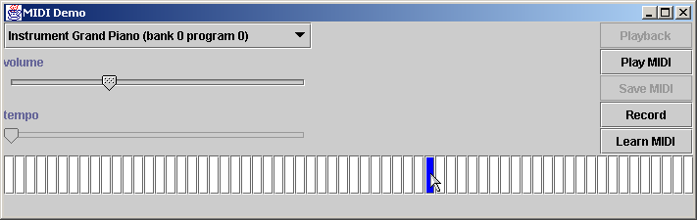
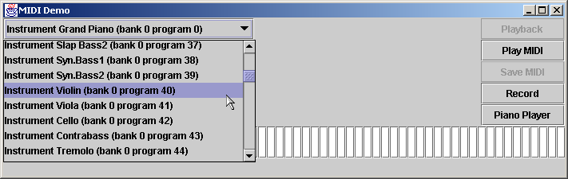
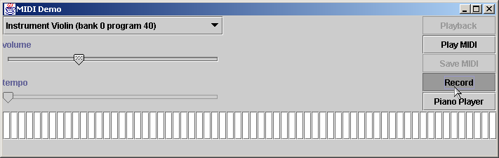
Fig. 22.10 MidiDemo provides the GUI that enables users to interact with the application
(Part 18).
Program Output

Slide 98
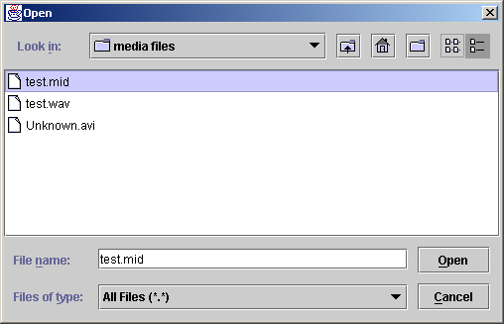
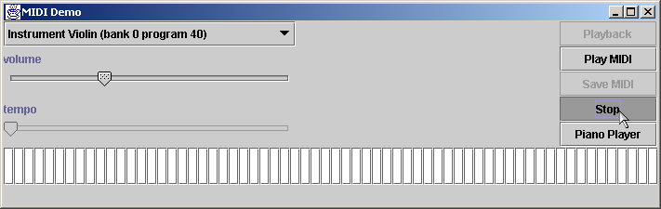
Fig. 22.10 MidiDemo provides the GUI that enables users to interact with the application
(Part 19).
Program Output

Slide 99
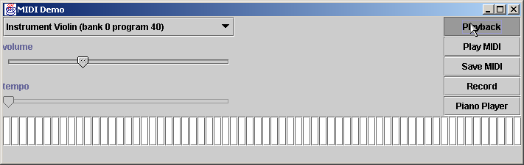
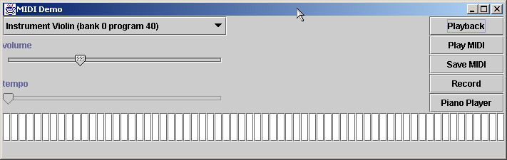
Fig. 22.10 MidiDemo provides the GUI that enables users to interact with the application
(Part 20).
Program Output

Slide 100

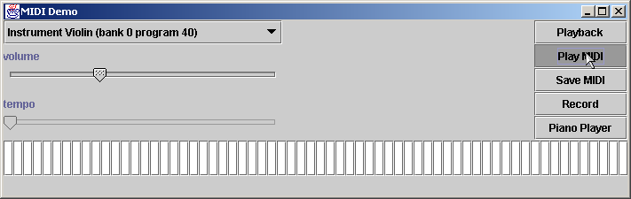
Fig. 22.10 MidiDemo provides the GUI that enables users to interact with the application
(Part 21).
Program Output

Slide 101
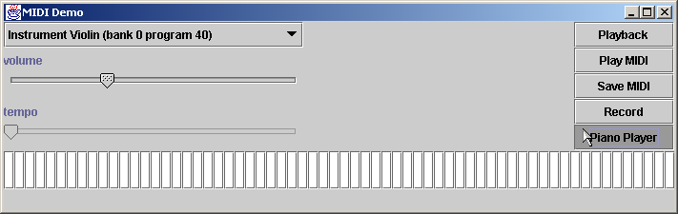
Fig. 22.10 MidiDemo provides the GUI that enables users to interact with the application
(Part 22).
Program Output

Slide 102
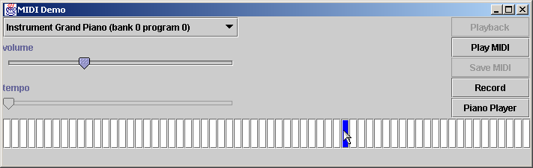
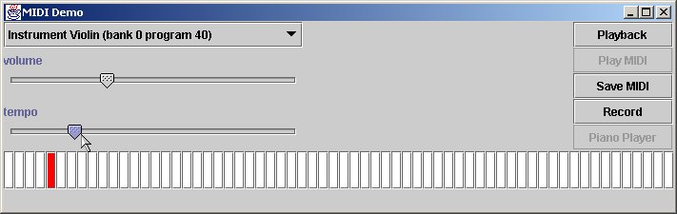
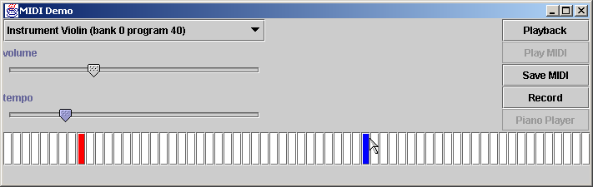
Fig. 22.10 MidiDemo provides the GUI that enables users to interact with the application
(Part 23).
Program Output

Slide 103
22.9 (Optional Case Study) Thinking About Objects: Animation and Sound in the View
ImagePanel
  Used for objects that are stationary in model
    e.g., Floor, ElevatorShaft
MovingPanel
  Used for objects that “move” in model
    e.g., Elevator
AnimatedPanel
  Used for objects that “animate” in model
    e.g., Person, Door, Button, Bell, Light

Slide 104
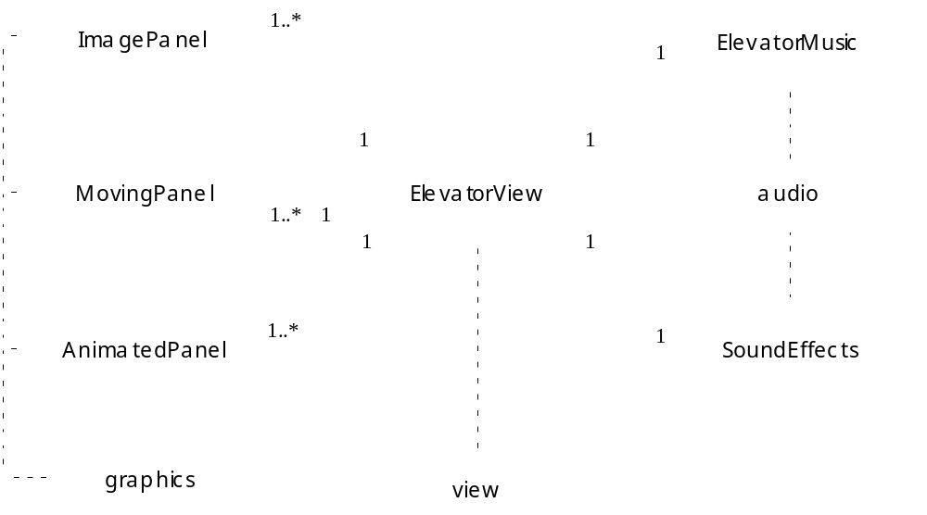
22.9 (Optional Case Study) Thinking About Objects: Animation and Sound in the View (cont.)
Fig 22.11 Class diagram of elevator simulation view.

Slide 105
Fig. 22.12 Class ImagePanel represents and displays a stationary object from the model.
Line 13
Line 16
Line 19
Line 25
1 // ImagePanel.java
2 // JPanel subclass for positioning and displaying ImageIcon
3 package com.deitel.jhtp4.elevator.view;
4
5 // Java core packages
6 import java.awt.*;
7 import java.awt.geom.*;
8 import java.util.*;
9
10 // Java extension packages
11 import javax.swing.*;
12
13 public class ImagePanel extends JPanel {
14
15 // identifier
16 private int ID;
17
18 // on-screen position
19 private Point2D.Double position;
20
21 // imageIcon to paint on screen
22 private ImageIcon imageIcon;
23
24 // stores all ImagePanel children
25 private Set panelChildren;
26
27 // constructor initializes position and image
28 public ImagePanel( int identifier, String imageName )
29 {
30 super( null ); // specify null layout
31 setOpaque( false ); // make transparent
32
33 // set unique identifier
34 ID = identifier;
35
ImagePanel extends JPanel, so ImagePanel can be displayed on screen
Each ImagePanel has a unique identifier
Point2D.Double offers precision for x-y position coordinate
Set of ImagePanel children

Slide 106
Fig. 22.12 Class ImagePanel represents and displays a stationary object from the model
(Part 2).
Lines 44-46
Lines 54-60
Lines 63-67
36 // set location
37 position = new Point2D.Double( 0, 0 );
38 setLocation( 0, 0 );
39
40 // create ImageIcon with given imageName
41 imageIcon = new ImageIcon(
42 getClass().getResource( imageName ) );
43
44 Image image = imageIcon.getImage();
45 setSize(
46 image.getWidth( this ), image.getHeight( this ) );
47
48 // create Set to store Panel children
49 panelChildren = new HashSet();
50
51 } // end ImagePanel constructor
52
53 // paint Panel to screen
54 public void paintComponent( Graphics g )
55 {
56 super.paintComponent( g );
57
58 // if image is ready, paint it to screen
59 imageIcon.paintIcon( this, g, 0, 0 );
60 }
61
62 // add ImagePanel child to ImagePanel
63 public void add( ImagePanel panel )
64 {
65 panelChildren.add( panel );
66 super.add( panel );
67 }
68
Use imageName argument to instantiate ImageIcon that will be displayed on screen
Display ImagePanel (and its ImageIcon) to screen
Override method add to add ImagePanel child

Slide 107
Fig. 22.12 Class ImagePanel represents and displays a stationary object from the model
(Part 3).
Lines 70-74
Lines 77-81
Lines 84-100
69 // add ImagePanel child to ImagePanel at given index
70 public void add( ImagePanel panel, int index )
71 {
72 panelChildren.add( panel );
73 super.add( panel, index );
74 }
75
76 // remove ImagePanel child from ImagePanel
77 public void remove( ImagePanel panel )
78 {
79 panelChildren.remove( panel );
80 super.remove( panel );
81 }
82
83 // sets current ImageIcon to be displayed
84 public void setIcon( ImageIcon icon )
85 {
86 imageIcon = icon;
87 }
88
89 // set on-screen position
90 public void setPosition( double x, double y )
91 {
92 position.setLocation( x, y );
93 setLocation( ( int ) x, ( int ) y );
94 }
95
96 // return ImagePanel identifier
97 public int getID()
98 {
99 return ID;
100 }
101
Overload method add to add ImagePanel child
Override method remove to remove ImagePanel child
Accessor methods

Slide 108
Fig. 22.12 Class ImagePanel represents and displays a stationary object from the model
(Part 4).
Lines 103-118
102 // get position of ImagePanel
103 public Point2D.Double getPosition()
104 {
105 return position;
106 }
107
108 // get imageIcon
109 public ImageIcon getImageIcon()
110 {
111 return imageIcon;
112 }
113
114 // get Set of ImagePanel children
115 public Set getChildren()
116 {
117 return panelChildren;
118 }
119 }
Accessor methods

Slide 109
Fig. 22.13 Class MovingPanel represents and displays a moving object from the model.
Line 13
Lines 20-21
1 // MovingPanel.java
2 // JPanel subclass with on-screen moving capabilities
3 package com.deitel.jhtp4.elevator.view;
4
5 // Java core packages
6 import java.awt.*;
7 import java.awt.geom.*;
8 import java.util.*;
9
10 // Java extension packages
11 import javax.swing.*;
12
13 public class MovingPanel extends ImagePanel {
14
15 // should MovingPanel change position?
16 private boolean moving;
17
18 // number of pixels MovingPanel moves in both x and y values
19 // per animationDelay milliseconds
20 private double xVelocity;
21 private double yVelocity;
22
23 // constructor initializes position, velocity and image
24 public MovingPanel( int identifier, String imageName )
25 {
26 super( identifier, imageName );
27
28 // set MovingPanel velocity
29 xVelocity = 0;
30 yVelocity = 0;
31
32 } // end MovingPanel constructor
33
MovingPanel represents moving object in model
Use double to represent velocity with high-precision

Slide 110
Fig. 22.13 Class MovingPanel represents and displays a moving object from the model (Part 2).
Lines 38-52
Lines 56-65
34 // update MovingPanel position and animation frame
35 public void animate()
36 {
37 // update position according to MovingPanel velocity
38 if ( isMoving() ) {
39 double oldXPosition = getPosition().getX();
40 double oldYPosition = getPosition().getY();
41
42 setPosition( oldXPosition + xVelocity,
43 oldYPosition + yVelocity );
44 }
45
46 // update all children of MovingPanel
47 Iterator iterator = getChildren().iterator();
48
49 while ( iterator.hasNext() ) {
50 MovingPanel panel = ( MovingPanel ) iterator.next();
51 panel.animate();
52 }
53 } // end method animate
54
55 // is MovingPanel moving on screen?
56 public boolean isMoving()
57 {
58 return moving;
59 }
60
61 // set MovingPanel to move on screen
62 public void setMoving( boolean move )
63 {
64 moving = move;
65 }
66
If MovingPanel is moving, update MovingPanel position, as well as position of MovingPanel’s children
Accessor methods

Slide 111
Fig. 22.13 Class MovingPanel represents and displays a moving object from the model (Part 3).
Lines 68-84
67 // set MovingPanel x and y velocity
68 public void setVelocity( double x, double y )
69 {
70 xVelocity = x;
71 yVelocity = y;
72 }
73
74 // return MovingPanel x velocity
75 public double getXVelocity()
76 {
77 return xVelocity;
78 }
79
80 // return MovingPanel y velocity
81 public double getYVelocity()
82 {
83 return yVelocity;
84 }
85 }
Accessor methods

Slide 112
Fig. 22.14 Class AnimatedPanel represents and displays an animated object from the model.
Line 12
Line 23
Lines 18-33
1 // AnimatedPanel.java
2 // MovingPanel subclass with animation capabilities
3 package com.deitel.jhtp4.elevator.view;
4
5 // Java core packages
6 import java.awt.*;
7 import java.util.*;
8
9 // Java extension packages
10 import javax.swing.*;
11
12 public class AnimatedPanel extends MovingPanel {
13
14 // should ImageIcon cycle frames
15 private boolean animating;
16
17 // frame cycle rate (i.e., rate advancing to next frame)
18 private int animationRate;
19 private int animationRateCounter;
20 private boolean cycleForward = true;
21
22 // individual ImageIcons used for animation frames
23 private ImageIcon imageIcons[];
24
25 // storage for all frame sequences
26 private java.util.List frameSequences;
27 private int currentAnimation;
28
29 // should loop (continue) animation at end of cycle?
30 private boolean loop;
31
32 // should animation display last frame at end of animation?
33 private boolean displayLastFrame;
34
AnimatedPanel represents moving object in model and has several frames of animation
ImageIcon array that stores images in an animation sequence
Variables to control animation rate and determine which frame of animation to display

Slide 113
Fig. 22.14 Class AnimatedPanel represents and displays an animated object from the model (Part 2).
Lines 44-49
Lines 56-70
Lines 61-69
35 // helps determine next displayed frame
36 private int currentFrameCounter;
37
38 // constructor takes array of filenames and screen position
39 public AnimatedPanel( int identifier, String imageName[] )
40 {
41 super( identifier, imageName[ 0 ] );
42
43 // creates ImageIcon objects from imageName string array
44 imageIcons = new ImageIcon[ imageName.length ];
45
46 for ( int i = 0; i < imageIcons.length; i++ ) {
47 imageIcons[ i ] = new ImageIcon(
48 getClass().getResource( imageName[ i ] ) );
49 }
50
51 frameSequences = new ArrayList();
52
53 } // end AnimatedPanel constructor
54
55 // update icon position and animation frame
56 public void animate()
57 {
58 super.animate();
59
60 // play next animation frame if counter > animation rate
61 if ( frameSequences != null && isAnimating() ) {
62
63 if ( animationRateCounter > animationRate ) {
64 animationRateCounter = 0;
65 determineNextFrame();
66 }
67 else
68 animationRateCounter++;
69 }
AnimatedPanel constructor creates ImageIcon array from String array argument, which contains names of image files
Override method animate of class MovingPanel to update AnimatedPanel position and current frame of animation
Play next frame of animation

Slide 114
Fig. 22.14 Class AnimatedPanel represents and displays an animated object from the model (Part 3).
Lines 73-99
Lines 84-93
Lines 88-91
Lines 96-97
70 } // end method animate
71
72 // determine next animation frame
73 private void determineNextFrame()
74 {
75 int frameSequence[] =
76 ( int[] ) frameSequences.get( currentAnimation );
77
78 // if no more animation frames, determine final frame,
79 // unless loop is specified
80 if ( currentFrameCounter >= frameSequence.length ) {
81 currentFrameCounter = 0;
82
83 // if loop is false, terminate animation
84 if ( !isLoop() ) {
85
86 setAnimating( false );
87
88 if ( isDisplayLastFrame() )
89
90 // display last frame in sequence
91 currentFrameCounter = frameSequence.length - 1;
92 }
93 }
94
95 // set current animation frame
96 setCurrentFrame( frameSequence[ currentFrameCounter ] );
97 currentFrameCounter++;
98
99 } // end method determineNextFrame
100
Utility method that determines next frame of animation to display
Used for looping purposes in animation: If loop is false, animation terminates after one iteration
Last frame in sequence is displayed if displayLastFrame is true, and first frame in sequence is displayed if displayLastFrame is false
Call method setCurrent-Frame to set ImageIcon (current image displayed) to the ImageIcon returned from the current frame sequence.

Slide 115
Fig. 22.14 Class AnimatedPanel represents and displays an animated object from the model (Part 4).
Lines 102-135
101 // add frame sequence (animation) to frameSequences ArrayList
102 public void addFrameSequence( int frameSequence[] )
103 {
104 frameSequences.add( frameSequence );
105 }
106
107 // ask if AnimatedPanel is animating (cycling frames)
108 public boolean isAnimating()
109 {
110 return animating;
111 }
112
113 // set AnimatedPanel to animate
114 public void setAnimating( boolean animate )
115 {
116 animating = animate;
117 }
118
119 // set current ImageIcon
120 public void setCurrentFrame( int frame )
121 {
122 setIcon( imageIcons[ frame ] );
123 }
124
125 // set animation rate
126 public void setAnimationRate( int rate )
127 {
128 animationRate = rate;
129 }
130
131 // get animation rate
132 public int getAnimationRate()
133 {
134 return animationRate;
135 }
Accessor methods

Slide 116
Fig. 22.14 Class AnimatedPanel represents and displays an animated object from the model (Part 5).
Lines 138-159
Lines 162-167
136
137 // set whether animation should loop
138 public void setLoop( boolean loopAnimation )
139 {
140 loop = loopAnimation;
141 }
142
143 // get whether animation should loop
144 public boolean isLoop()
145 {
146 return loop;
147 }
148
149 // get whether to display last frame at animation end
150 private boolean isDisplayLastFrame()
151 {
152 return displayLastFrame;
153 }
154
155 // set whether to display last frame at animation end
156 public void setDisplayLastFrame( boolean displayFrame )
157 {
158 displayLastFrame = displayFrame;
159 }
160
161 // start playing animation sequence of given index
162 public void playAnimation( int frameSequence )
163 {
164 currentAnimation = frameSequence;
165 currentFrameCounter = 0;
166 setAnimating( true );
167 }
168 }
Accessor methods
Begin animation

Slide 117
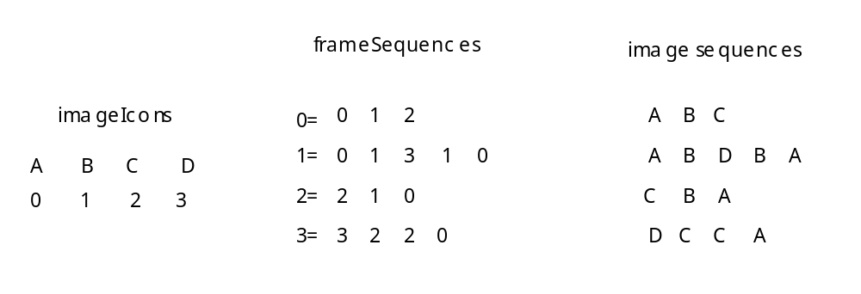
22.9 (Optional Case Study) Thinking About Objects: Animation and Sound in the View
22.15 Relationship between array imageIcons and List frameSequences.

Slide 118
Fig. 22.16 Class SoundEffects returns AudioClip objects.
Line 8
Lines 19-20
1 // SoundEffects.java
2 // Returns AudioClip objects
3 package com.deitel.jhtp4.elevator.view;
4
5 // Java core packages
6 import java.applet.*;
7
8 public class SoundEffects {
9
10 // location of sound files
11 private String prefix = "";
12
13 public SoundEffects() {}
14
15 // get AudioClip associated with soundFile
16 public AudioClip getAudioClip( String soundFile )
17 {
18 try {
19 return Applet.newAudioClip( getClass().getResource(
20 prefix + soundFile ) );
21 }
22
23 // return null if soundFile does not exist
24 catch ( NullPointerException nullPointerException ) {
25 return null;
26 }
27 }
28
29 // set prefix for location of soundFile
30 public void setPathPrefix( String string )
31 {
32 prefix = string;
33 }
34 }
Creates sound effects (AudioClips) for view
Pass soundFile parameter to static method newAudioClip (of class java.applet.Applet) to return AudioClip object

Slide 119
Fig. 22.17 Class ElevatorMusic plays music when a Person rides in the Elevator.
Line 12
Lines 31-33
1 // ElevatorMusic.java
2 // Allows for MIDI playing capabilities
3 package com.deitel.jhtp4.elevator.view;
4
5 // Java core packages
6 import java.io.*;
7 import java.net.*;
8
9 // Java extension packages
10 import javax.sound.midi.*;
11
12 public class ElevatorMusic implements MetaEventListener {
13
14 // MIDI sequencer
15 private Sequencer sequencer;
16
17 // should music stop playing?
18 private boolean endOfMusic;
19
20 // sound file name
21 private String fileName;
22
23 // sequence associated with sound file
24 private Sequence soundSequence;
25
26 // constructor opens a MIDI file to play
27 public ElevatorMusic( String file )
28 {
29 // set sequencer
30 try {
31 sequencer = MidiSystem.getSequencer();
32 sequencer.addMetaEventListener( this );
33 fileName = file;
34 }
35
Creates “elevator music” (music heard when Person rides Elevator) for view
Initialize system’s MIDI sequencer and registers class ElevatorMusic for MetaMessage events from sequencer

Slide 120
Fig. 22.17 Class ElevatorMusic plays music when a Person rides in the Elevator (Part 2).
Lines 54-55
36 // handle exception if MIDI is unavailable
37 catch ( MidiUnavailableException midiException ) {
38 midiException.printStackTrace();
39 }
40 } // end ElevatorMusic constructor
41
42 // open music file
43 public boolean open()
44 {
45 try {
46
47 // get URL for media file
48 URL url = getClass().getResource( fileName );
49
50 // get valid MIDI file
51 soundSequence = MidiSystem.getSequence ( url );
52
53 // open sequencer for specified file
54 sequencer.open();
55 sequencer.setSequence( soundSequence );
56 }
57
58 // handle exception if URL does not exist
59 catch ( NullPointerException nullPointerException ) {
60 nullPointerException.printStackTrace();
61 return false;
62 }
63
64 // handle exception if MIDI data is invalid
65 catch ( InvalidMidiDataException midiException ) {
66 midiException.printStackTrace();
67 soundSequence = null;
68 return false;
69 }
70
Open sequencer for specified file and validate MIDI data

Slide 121
Fig. 22.17 Class ElevatorMusic plays music when a Person rides in the Elevator (Part 3).
Lines 88-92
71 // handle IO exception
72 catch ( java.io.IOException ioException ) {
73 ioException.printStackTrace();
74 soundSequence = null;
75 return false;
76 }
77
78 // handle exception if MIDI is unavailable
79 catch ( MidiUnavailableException midiException ) {
80 midiException.printStackTrace();
81 return false;
82 }
83
84 return true;
85 }
86
87 // play MIDI track
88 public void play()
89 {
90 sequencer.start();
91 endOfMusic = false;
92 }
93
94 // get sequencer
95 public Sequencer getSequencer()
96 {
97 return sequencer;
98 }
99
Start sequencer and play MIDI file

Slide 122
Fig. 22.17 Class ElevatorMusic plays music when a Person rides in the Elevator (Part 4).
100 // handle end of track
101 public void meta( MetaMessage message )
102 {
103 if ( message.getType() == 47 ) {
104 endOfMusic = true;
105 sequencer.stop();
106 }
107 }
108 }

